Slide 1

crime
Knowledge Discovery for Crimes
Against Children
DAEN 690 Project
Summer 2019
FINAL Presentation
AUGUST 6, 2019

Slide 2
Team KD-CAC Organization
Team Roles
Product Owner – Robert Grillo
Scrum Master – Waliyat Olayiwola
Developer – Xianci Tang
Developer – Nikhitha Lingutla
Developer – Yao Zhang
Tools
YouTrack for tracking all Sprints
Blackboard and Google Drive for file sharing, and online meetings via Blackboard Collaborate
R, Python, Jupyter Notebook, ARGO Cluster, Tableau, Microsoft Excel, and Watson for knowledge discovery

Slide 3
Problem Definition and Project Plan

Slide 4
Problem Objective
Mission Challenge
End Users
Law enforcement agencies
Social workers
School teachers/administrators
Childcare providers
Healthcare providers
Parents
Researchers
To discover and share data-driven knowledge about crimes against children through opportunistic data mining

Slide 5
Research Questions
What characteristics of crimes against children are most associated with each type of offense category?
How can crime data be used to predict the likelihood of a victimized child falling into a particular offense category given various known circumstances?
To what extent are state/county-level socioeconomic indicators associated with crimes against children?
Notes:
Scenario #1
School administrators are interested in producing a training module for employees to raise awareness of the characteristics of crimes against children that are most associated with particular types of offenses. The literature they find is largely anecdotal. The unsupervised methods executed during this project may reveal new, data-driven information that could help improve a training module of such a nature.
Scenario #2
An investigator is provided a limited set of details related to a crime that took place, or is believed to have taken place, against a child, including information associated with various suspects and possible locations where the crime may have taken place. The investigator can use the predictive models developed in this project to “what-if” scenarios to estimate the probability of each crime type given the inputs provided for the scenario.
Scenario #3
A parent is considering moving to another county in the United States and is concerned about his or her children being a victim of a particular type of crime. The geospatial analysis produced in this project can inform the parent of how the socio-economic conditions of a county influence the various types of crimes against children.

Slide 6
Scope
Emphasized interpretable data science methods
Crimes involving property or against society were ignored
4 years of crime data
(2013 – 2016)
Did not include in-depth
temporal trend analysis

Slide 7
Data Acquisition and Preparation

Slide 8
System for Collecting Crime Data
Over 5.5 million offenses per year
Uniform crime reporting
Organized to reflect the many different aspects of criminal incidents
11 linked flat files released each year
Victim, offender, and other incident characteristics for all offenses

Slide 9


Socio-Economic Dataset
Individual county population estimates of those under the age of 18 (2013 to 2016)
National Institute of Health -
National Cancer Institute
Poverty rate and unemployment rate averages for counties from 2013 to 2017
U.S. Census Bureau

Slide 10
NIBRS Dataset Construction
Victim File
Victim-Offense-Offender as Rows
Offender File
Offense File
Notes:
Five “Segment” files from each year (2013 – 2016)
Started with Victim file
Reduced to victims under the age of 18
Created 1 row for each victim-offense association
(Up to 10 offenses per victim )
Filter down to offenses of interest
Created 1 row for each victim-offense-offender association
(Up to 10 offenders per victim)
Execute a series of left join operations to the modified Victim data frame
Victim ← Offense ← Offender ← Batch Header ← Administrative
Repeat for files from each year
Bind rows and condition data

Slide 11
NIBRS Predictor Overview
58 Initial Predictors
1,137,211 Observations
Victim Information
Age of Victim
Offender Information
Sex of Victim
Race of Victim
Ethnicity of Victim
Residence Status of Victim
Injury Types
Offender Relationship
Age of Offender
Sex of Offender
Race of Offender
Ethnicity of Offender
Offender Suspected of Using Alcohol
Offender Suspected of Using Computer Equipment
Offender Suspected of Using Drugs
Offense Information
Incident Date Hour
Offense Attempted Completed
Location Category
Hate Crime
Offense Circumstances
Weapon or Force Used

Slide 12
Target Variable Labeling
NIBRS Code | NIBRS Offense Name | KD-CAC Offense Category
13A | Aggravated Assault | Assault
13B | Simple Assault
13C | Intimidation
11A | Rape | Sex Offense
11B | Sodomy
11C | Sexual Assault With An Object
11D | Fondling, Indecent Liberties, Child Molesting
36A | Incest Statutory Rape
36B
100 | Kidnaping Abduction | Kidnaping/Abduction
09A | Murder Nonnegligent Manslaughter | Homicide
09B | Negligent Manslaughter | Negligent Manslaughter
64B | Human Trafficking Involuntary Servitude | Human Trafficking
64A | Human Trafficking Commercial Sex Acts
Notes:
These are the only offenses we are concerned about in this project – where there is an identified victim under the age of 18

Slide 13
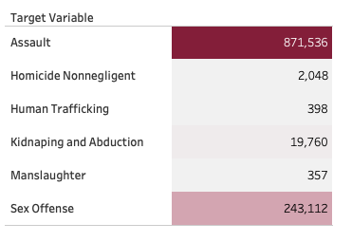
Target Variables

Slide 14
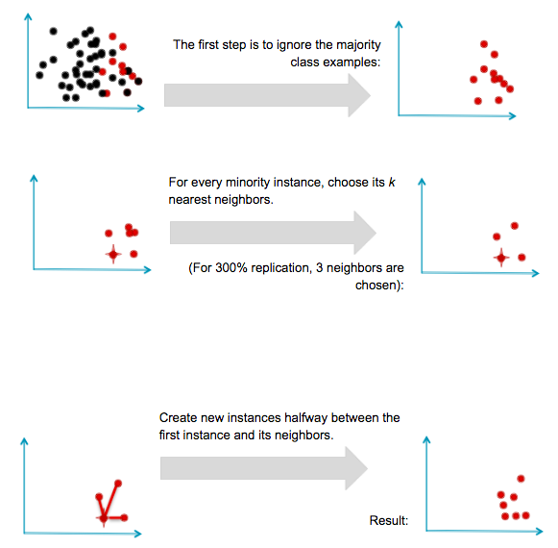
Data Balancing with SMOTE
Several ways to balance the training set:
Oversample the minority class by replicating observations
Artificially lowers variance
Undersample the majority class
Information lost from throwing away data
Synthesize new minority classes by interpolating between existing ones
Synthetic Minority Oversampling Technique (SMOTE): Creates artificial data based on feature space based on similarities from minority samples
svds.com/learning-imbalanced-classes

Slide 15
Analytics and Visualization

Slide 16

Geo-spatial Visualizations

Slide 17
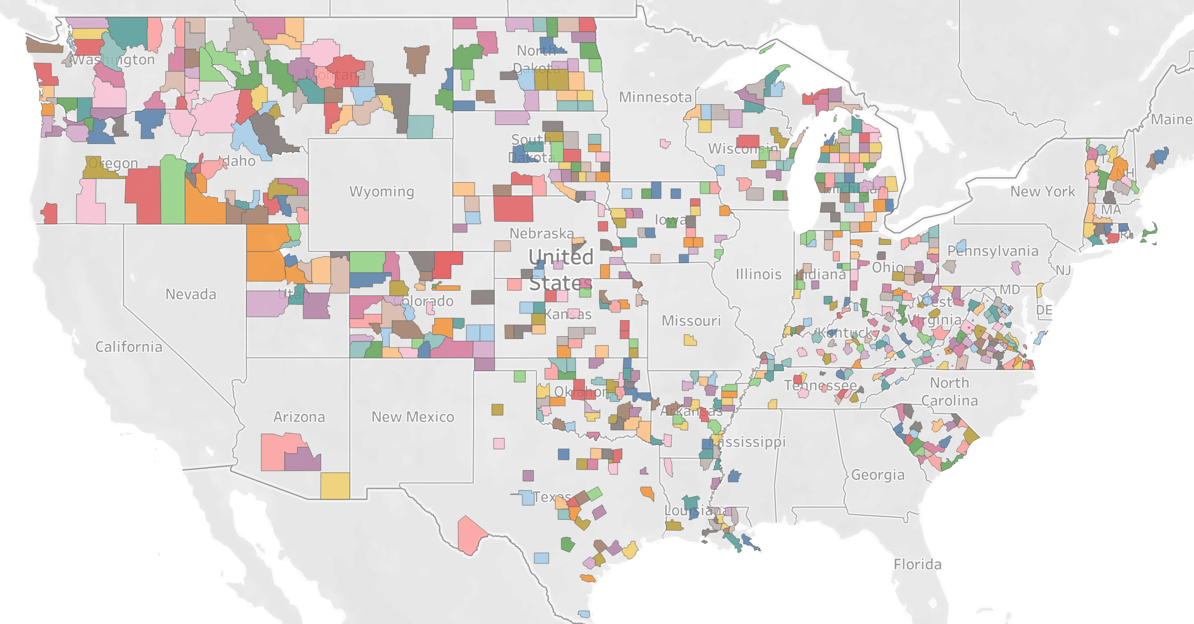
Counties Participating in NIBRS

Slide 18
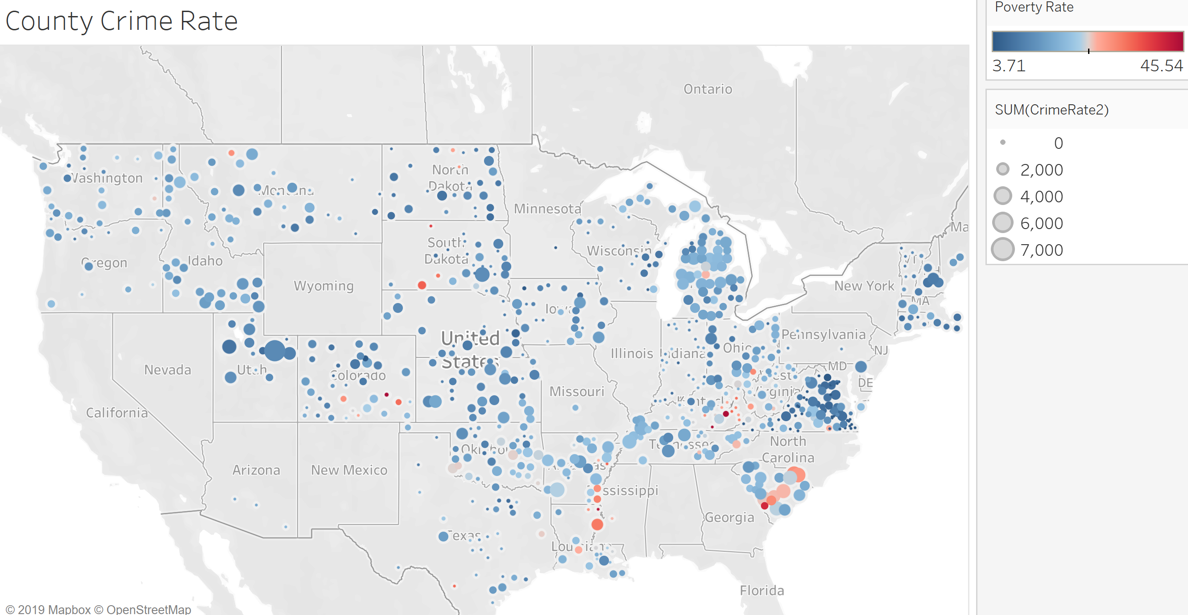
Poverty Rate vs Crime Rate

Slide 19
Dashboard
Demonstration

Slide 20

Model Development

Slide 21
Model Development Process
Penalized Logistic Regression
Decision Trees
K-Modes Clustering
Model
Exploration &
Prototyping
Phase
Neural Network
Random Forest
Association Rules
Hierarchical Clustering
Bayesian Network
Gradient Boosting
In-depth Model Fitting and Tuning
Phase
Hierarchical Clustering
Penalized Logistic Regression
Bayesian Network
Gradient Boosting
Model
Comparison
Phase
Compare
Selected
Models
Unsupervised Methods
Linear Classification
Non-linear Classification
Tree-based Classification

Slide 22
Agglomerative Hierarchical Clustering
Clustering features on the basis of the observations
More common to cluster observations
Just need to transpose the matrix
Agglomerative approach
Start with the points as individual clusters
At each step, merge a pair of clusters until only one cluster left
No need to specific number of clusters
Requirements
Measure of distance between features (similarity)
Method for merging clusters

Slide 23
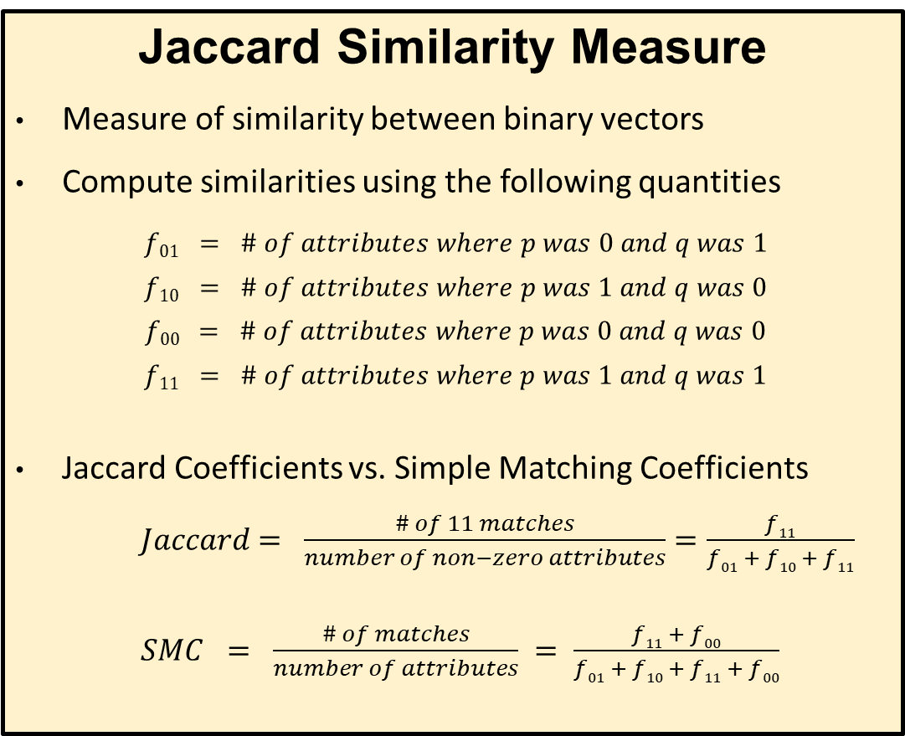
Jaccard Similarity Measure
Measure of similarity between binary vectors
Compute similarities using the following quantities
$$f01 = \# of attributes where p was 0 and q was 1$$
$$f10 = \# of attributes where p was 1 and q was 0$$
$$f00 = \# of attributes where p was 0 and q was 0$$
$$f11 = \# of attributes where p was 1 and q was 1$$
Jaccard Coefficients vs. Simple Matching Coefficients
$Jaccard = \frac{\# of 11 matches}{number of non−zero attributes}=\frac{f11}{f01 + f10 + f11}$
$SMC = \frac{\# of matches}{number of attributes} = \frac{f11 + f00}{f01 + f10 + f11 + f00}$
Ward’s Clustering Method
Minimizes the total within-cluster variance
At each step, find the pair of clusters that leads to minimum increase in total within-cluster variance after merging
Less susceptible to noise and outliers

Slide 24
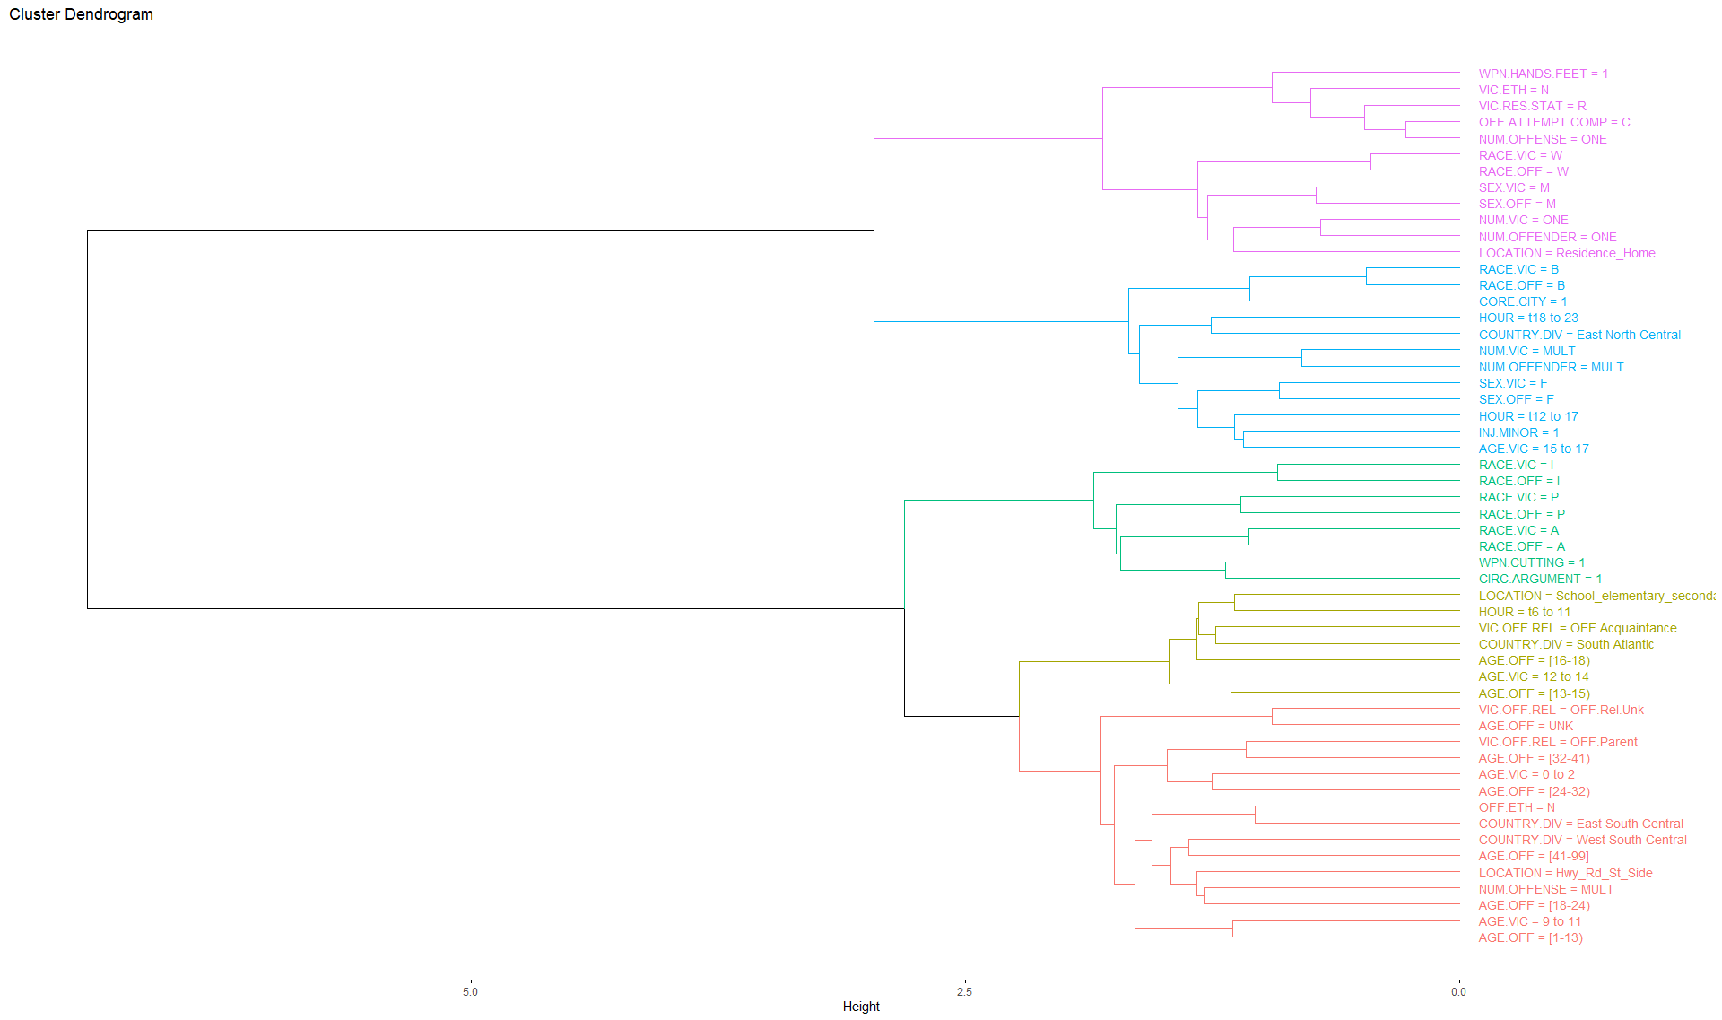
Assault

Slide 25
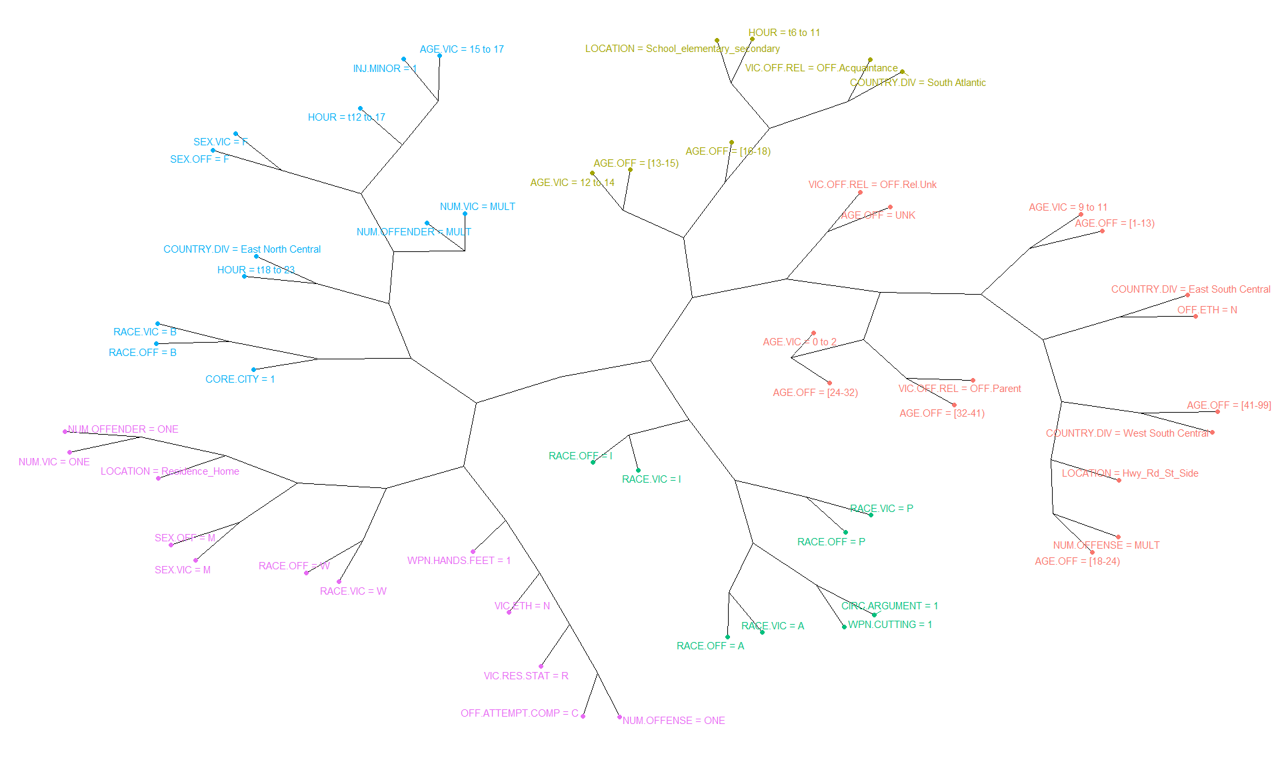
Assault
Victim aged 12 to 14
Offender age is 13 to 18
Time is 0600 to 1100
At schools within the South-Atlantic country division
Female victim aged 15 to 17
Offender is Female
Time is 1200 to 2300
Minor Injuries
Multiple victims, offenders, and offenses
In a city environment within the East-North Central country division
Victim aged 0 to 2 or 9 to 11
Offender aged 1 to 13 or 24 to 32
Offender is parent or of unknown relationship
In the East-South-Central country division
Victim is male
Offender is male
Offense occurs in a residence/home
Using hands/feet as weapons
One victim, one offender, one offense
Offender age 18 to 24 and 41 or older
Multiple offenses
Offense take place along roads/highways
In the West-South-Central country division

Slide 26
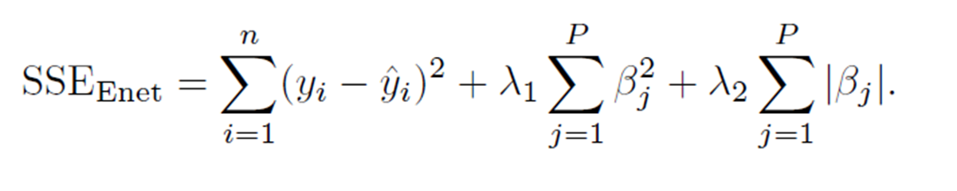
Logistic Regression with Elastic Net
Tuned Alpha and Lambda Using Grid Search
Model | Alpha | Lambda | Accuracy | AUC | Sensitivity | Specificity
Assault | 1.00 | 0.0001 | 0.843 | 0.921 | 0.849 | 0.838
Sex Offense | 0.50 | 0.00001 | 0.864 | 0.938 | 0.854 | 0.875
Homicide | 0.75 | 0.00001 | 0.917 | 0.971 | 0.905 | 0.928
Kidnapping/Abduction | 1.00 | 0.0001 | 0.859 | 0.926 | 0.869 | 0.849

Slide 27
Variable Influence Comparison Across Models
Predictive Influence Scale

Slide 28
Bayesian Network

Slide 29
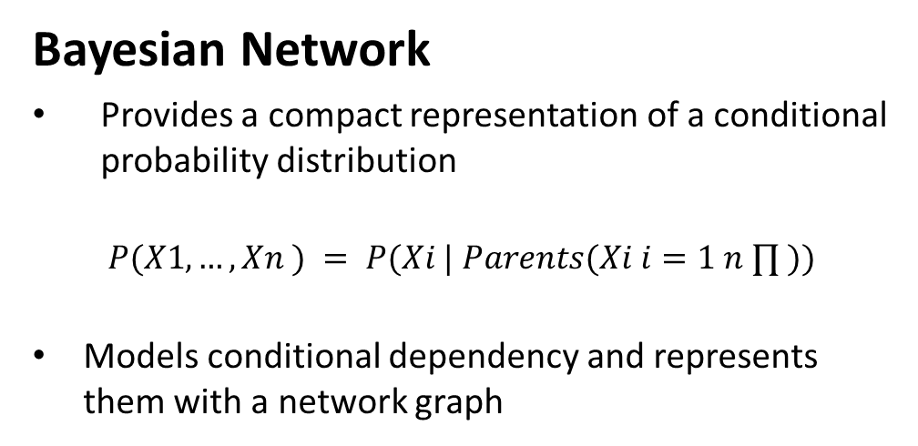
Bayesian Network
Provides a compact representation of a conditional probability distribution
$$P(X1, …, Xn ) = P(Xi | Parents(Xi i=1 n ∏ ))$$
Models conditional dependency and represents them with a network graph
Network graph
The parent is identified and the correlation between each pair of variables is measured and the edges are added
Each node X has a conditional probability table (CPT) representing P(X | Parents(X) )
IBM Watson - SPSS Modeler
Algorithm
Tree Augmented Naïve Bayes (TAN)
Reduces computational complexity and maintains structure by adding edges between variables
Notes:
https://bmcbioinformatics.biomedcentral.com/articles/10.1186/1471-2105-13-S15-S14
http://pages.cs.wisc.edu/~dpage/cs760/BNall.pdf

Slide 30
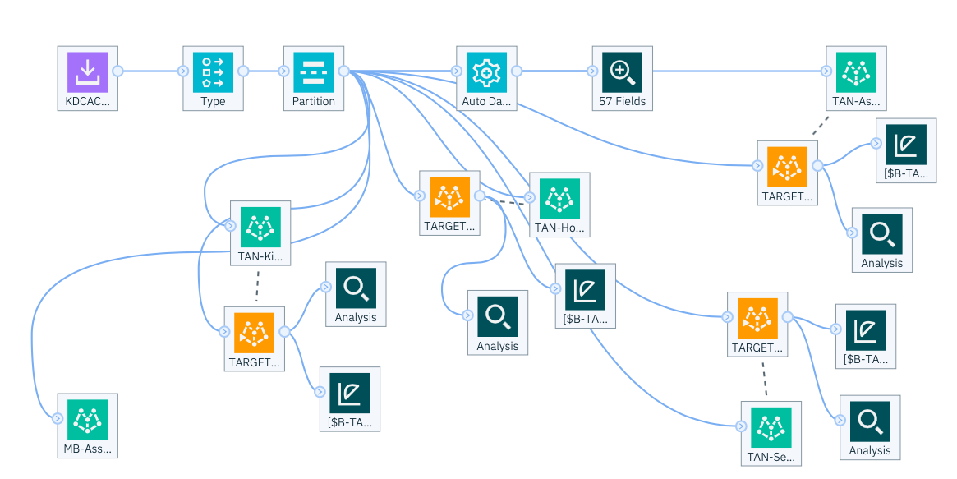
Bayesian Network Modeling Framework – IBM Watson SPSS Modeler

Slide 31
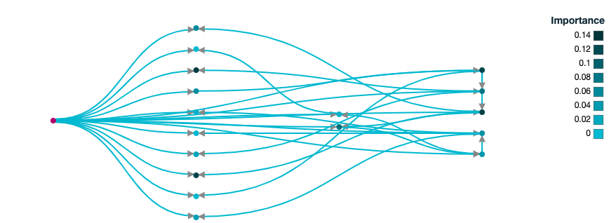
BAYESIAN NETWORK – NETWORK GRAPH WITHOUT NODES
Nodes represent variables
Edges represent conditional dependency
Deeper color nodes represent variable importance

Slide 32
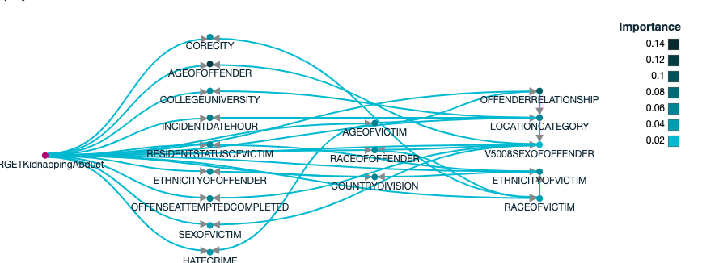
KIDNAPPING/ABDUCTION NETWORK GRAPH
Offender Relationship
Race of Victim

Slide 33
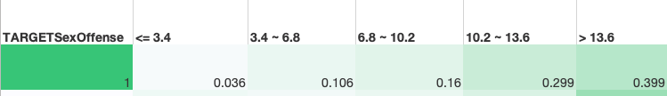
Sex Offense – Victims Age Node
Children aged 14 and over are more likely to be a victim of a sex offense compared to those in each of the younger age groups

Slide 34
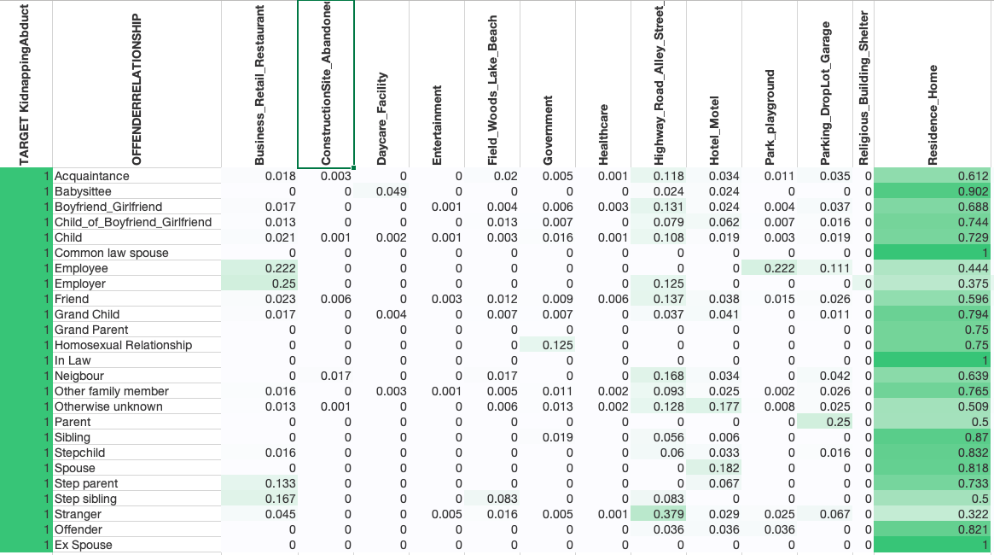
Kidnapping/Abduction – Location Category Node
Residence/Home
Babysitters
The most common location for Kidnapping/Abduction to happen is the victim’s residence/home compared to other locations
The likelihood is higher for certain relationships
Grandparents
Siblings
Step-Parents

Slide 35
Bayesian Network Models Performance

Slide 36
testing deployed model
Given a child is believed to be at risk for a crime with certain known conditions, what is the likelihood that the crime will be an Assault?
Query(model, Event((Crime=Assault),
Parameter({
“Fields”:[“Age of Victim”, ”Sex of Victim”, “Race of Victim”, “Ethnicity of Victim”, “Resident Status of Victim”, ”Offender Relationship”, “Age of Offender”, ”Sex of Offender”, “Race of Offender”, “Ethnicity of Offender”, “Location Category”, “Country Division”],”values”:11, Female, Black, Non-Hispanic or Latino, Resident, Offender is a stranger, 14, Female, Black, Non-Hispanic or Latino, School, South Atlantic”]
}))

Slide 37
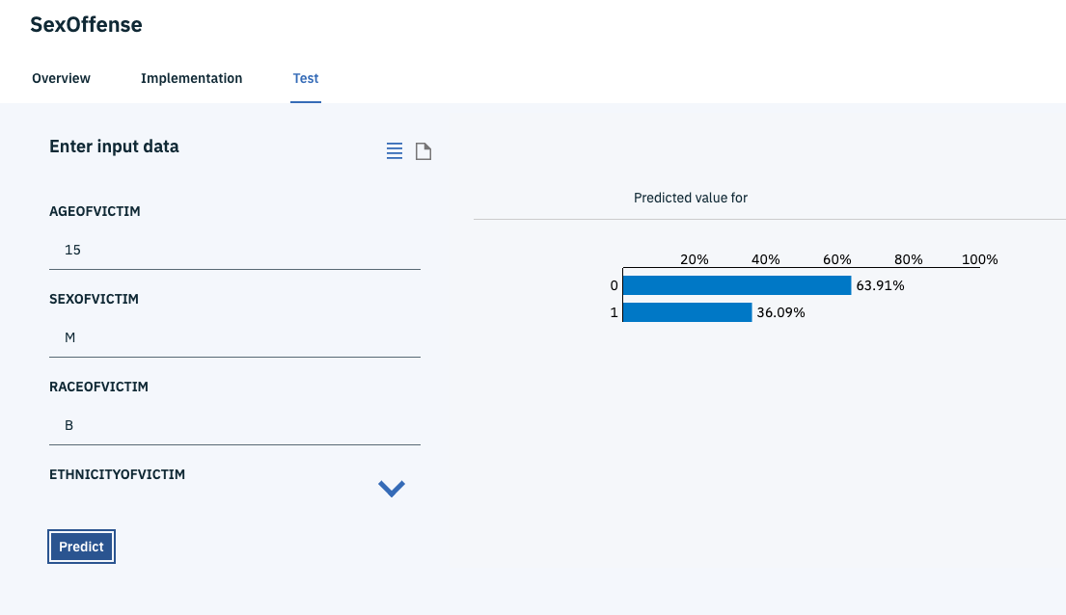

Slide 38
Offense Type | Likelihood
Likelihood that the crime will be a Sex Offense | 0.023
Likelihood that the crime will be an Assault | 0.957
Likelihood that the crime will be a Homicide | 0.004
Likelihood that the crime will be Kidnapping/Abduction | 0.036
Offense with the highest likelihood is Assault
Age of offender and age of victim is less than 15
Sex of offender and sex of victim is female
Location Category is school

Slide 39
XGBoost

Slide 40
XGBoost Tuning
Used Hyper Parameter tuning method
Selected parameters tuned:
max_depth
Maximum tree depth for base learners
learning_rate "eta"
Boosting learning rate
n_estimators
Number of boosted trees to fit
subsample
Subsample ratio of the training instance
min_child_weight
Minimum sum of instance weight (hessian) needed in a child
colsample_bytree
Subsample ratio of columns when constructing each tree

Slide 41
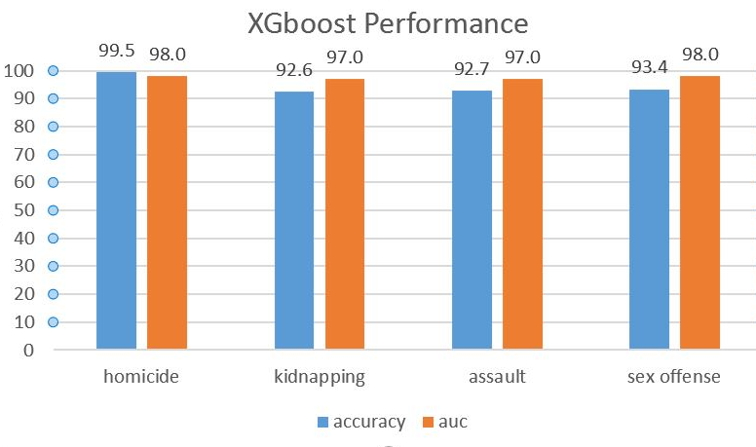
XGBoost Models Result Summary

Slide 42
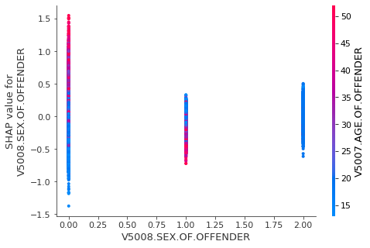
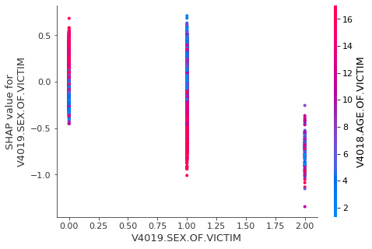
Kidnapping/Abduction
SHAP - Shapley Additive Explanation
Simple Dependent Plots
Older aged females are more likely to commit kidnapping than young females
Younger and middle-aged males are more likely to kidnap than older aged males
Teenage girls are more vulnerable to kidnapping than younger girls
Younger boys are more vulnerable to kidnapping than teenage boys

Slide 43
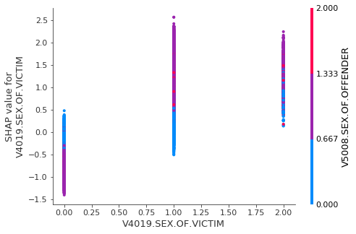
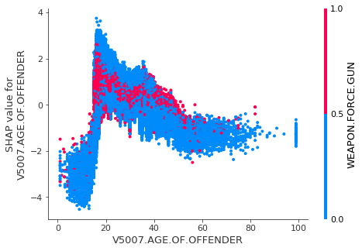
Simple Dependent Plots
SHAP - Shapley Additive Explanation
Assault
Homicide
Females tend to assault other females, while males tend to assault other males
The likelihood of offender age jumps at 20 and stays high through age 40
Use of a gun follows similar pattern

Slide 44
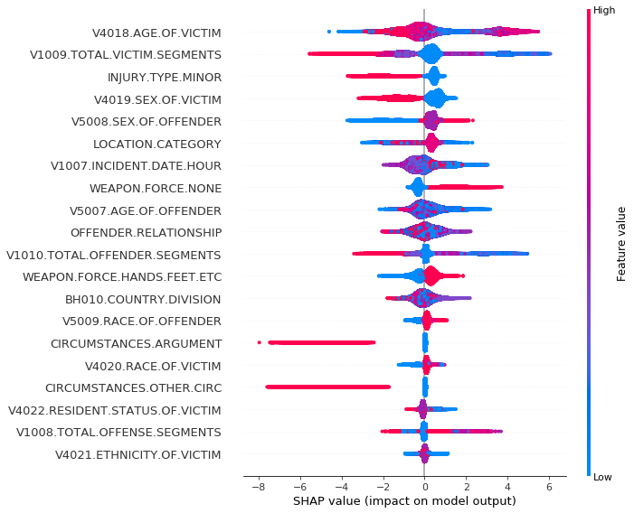
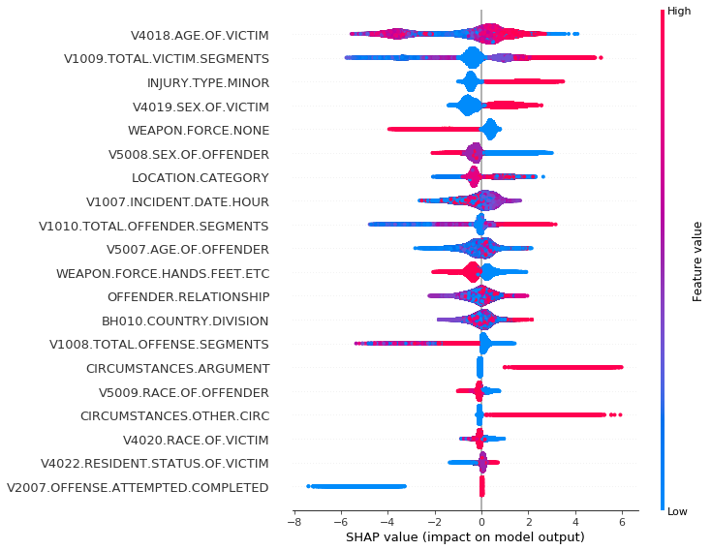
Sex Offense vs. Assault
SHAP - Shapley Additive Explanation

Slide 45
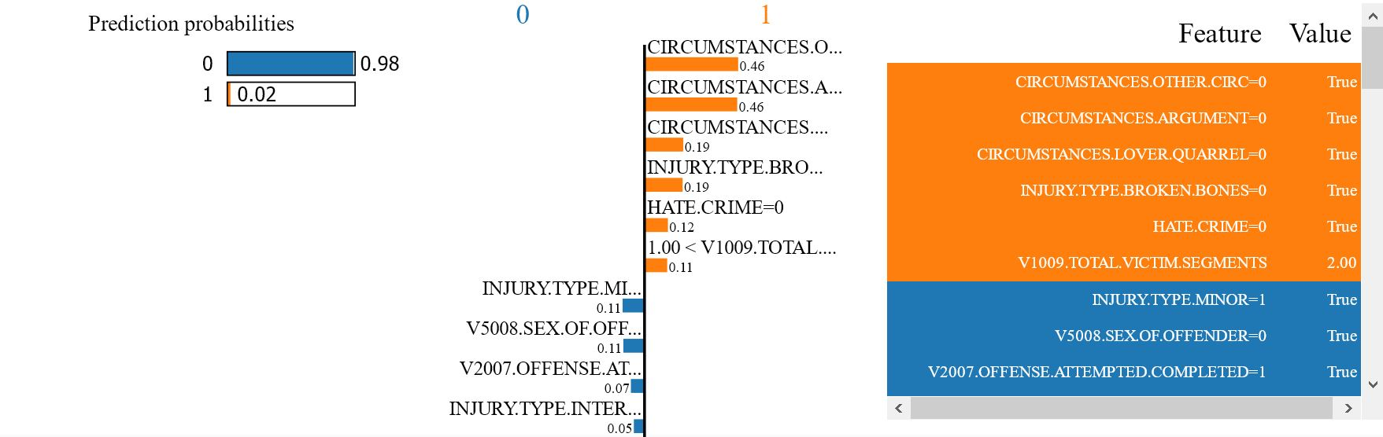
Sex Offense: Observation 144
LIME - Local Interpretable Model-Agnostic Explanations

Slide 46
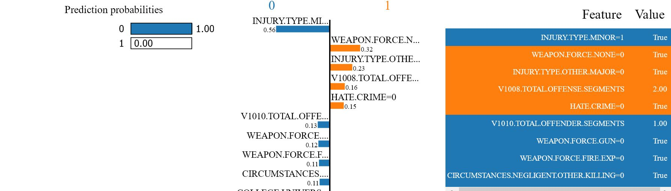
Homicide: Observation 144
LIME - Local Interpretable Model-Agnostic Explanations

Slide 47
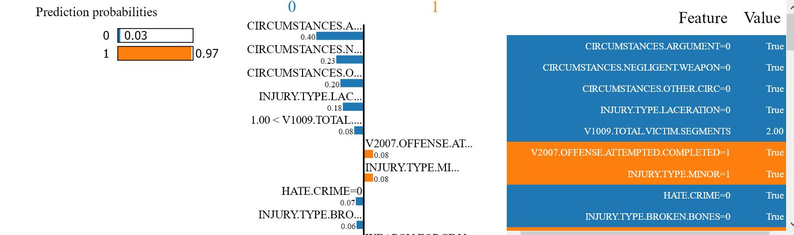
Assault: Observation 144
LIME - Local Interpretable Model-Agnostic Explanations

Slide 48
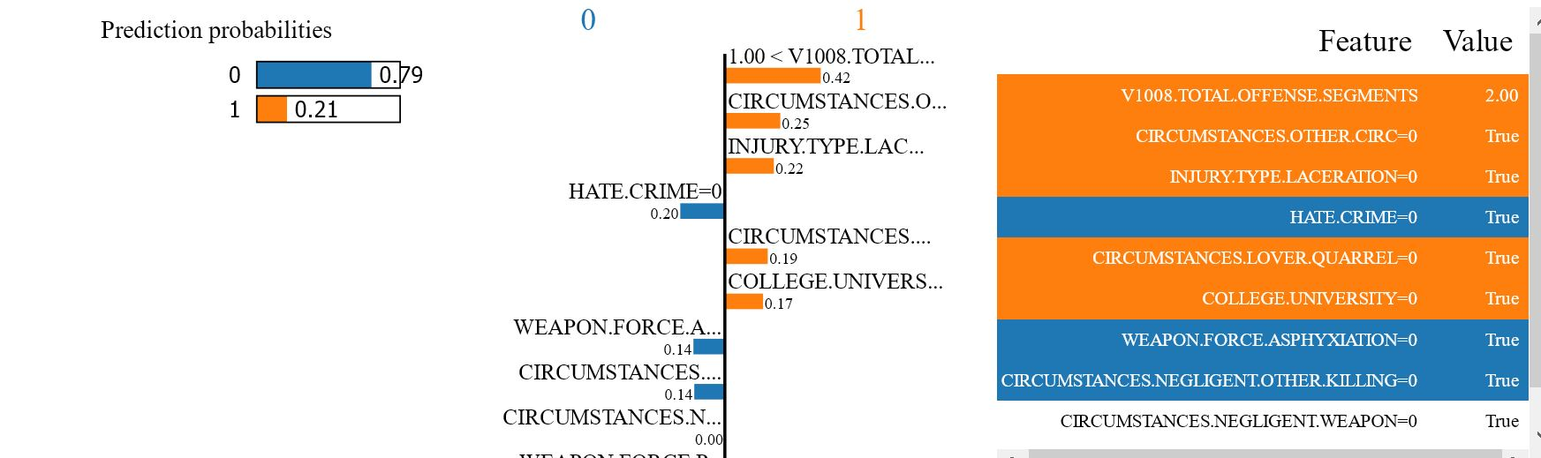
Kidnapping: Observation 144
LIME - Local Interpretable Model-Agnostic Explanations

Slide 49
Summary of Findings
Geospatial
Exploration
Poverty rates do not appear to be closely associated with crime rates
Residences, daycares, and schools are among the least safe locations for Sex Offense and Kidnapping/Abduction
Kidnapping/
Abduction
Most predictive characteristics: serious injuries; location either in hotel/motel or unknown; offender is boyfriend/girlfriend, a stranger, or unknown; involves a gun or cutting weapon; involves multiple offenses; offense is attempted rather than completed
The most common location is the victim's residence/home and the likelihood is higher for certain relationships
Older aged females are more likely to commit kidnapping than young females, while younger and middle-aged males are more likely to kidnap than older aged males
Teenage girls are more vulnerable to kidnapping than younger girls, while younger boys are more vulnerable to kidnapping than teenage boys

Slide 50
Summary of Findings
Sex Offense
Most predictive characteristics: known circumstances; does not involve an argument; result in serious injuries (often internal); sex of offender is male or unknown; does not involve weapons; offender is a friend; occurs between 0000 and 0600 hours; takes place in a residence/home
Children above age 14 are more likely to be a victim of sex offense compared to those in age groups younger than 14
Assault
Most predictive characteristics: offense completed; involves an argument; minor injuries; use of a weapon; college/university location; offender is sibling or victim is offender; other circumstances
Females tend to assault other females, causing minor injuries
Males tend to assault other males inside the residence/home, using hands/feet as weapons
Homicide
Most predictive characteristics: use of a weapon (gun, knife, blunt, vehicle); sibling or unknown relationship; major injuries; gang-related circumstances; field/lake/woods/beach location
The likelihood of offender age and use of a gun jumps at age 20 and stays high through age 40

Slide 51
Future Work Recommendations
Feature generation
e.g., race difference/same, age differences
Include socioeconomic data as predictors
Expand range of NIBRS data used
Load & explore association rules in network visualization software
(i.e. Gephi)
Multi-class and multi-label predictive models
In-depth
time series analysis
Subject matter expert informed Bayesian belief network
Geospatial-specific predictors
Expand techniques to crimes against adults, certain genders, elderly, hate crimes

Slide 52

Q & A

Slide 53
Backup

Slide 54
References
Association of State Uniform Crime Reporting Programs (ASUCRP) “National Incident Based Reporting System (NIBRS) – Association of State Uniform Crime Reporting Programs.” n.d. Accessed June 8, 2019. http://www.asucrp.net/uniform-crime-reporting-program/national-incident-based-reporting-system-nibrs/.
Association of State Uniform Crime Reporting Programs (ASUCRP). Uniform Crime Reporting Program – Association of State Uniform Crime Reporting Programs. (2019). Retrieved July 20, 2019, from http://www.asucrp.net/uniform-crime-reporting-program/
Chow, C.K. & C.N. Liu (1968). Approximating discrete probability distributions with dependence trees. IEEE Trans. on Info. Theory, 14, 462- 467.
David Finkelhor, and Anne Shattuck. “Characteristics of Crimes against Juveniles,” 2012. https://www.academia.edu/9728770/Characteristics_of_crimes_against_juveniles.
David Finkelhor. “About the Crimes Against Children Research Center (CCRC).” Research. 1999. http://www.unh.edu/ccrc/about-ccrc.html.
Fawcett, Tome. “Learning from Imbalanced Classes.” Silicon Valley Data Science. (2016). Retrieved July 28, 2019, from https://www.svds.com/learning-imbalanced-classes/
Finkelhor, D., & Ormrod, R. (2001). Crimes Against Children by Babysitters. PsycEXTRA Dataset. doi:10.1037/e317992004-001
Friedman, N., Geiger, D., & Goldszmidt, M. (1997). Bayesian network classifiers. Machine learning, 29(2), 131-163.
James, G., Witten, D., Hastie, T., & Tibshirani, R. (Eds.). (2013). An introduction to statistical learning: With applications in R. New York: Springer.
Kilpatrick, D.C., Edmunds, C., Seymour, A. 1992. "Rape in America: A Report to the Nation" from "The National Women’s Study" sponsored by the National Institute of Drug Abuse, National Victim’s Center and National Crime Victims Research and Treatment Center at the Medical University of South Carolina. Washington, DC.

Slide 55
References
Koller, D., & Friedman, N. (2009). Probabilistic graphical models: Principals and techniques MIT Press. ISBN 978-0262013192
Koller, D., Friedman, N., Getoor, L., & Taskar, B. (2007). Graphical models in a nutshell. In L. Getoor, & B. Taskar (Eds.), An introduction to statistical relational learning () MIT Press.
Lundberg, Scott. “Documentation by example for shap.dependence_plot.” (n.d.). Retrieved July 28, 2019, from https://slundberg.github.io/shap/notebooks/plots/dependence_plot.html
Lundberg, Scott. “Interpretable Machine Learning with XGBoost.” Towards Data Science. (2018). Retrieved July 28, 2019, from https://towardsdatascience.com/interpretable-machine-learning-with-xgboost-9ec80d148d27
Matlab Correlation coefficient for non-dichotomous nominal variable and ordinal or numeric variables. Cross Validated. (2013). Retrieved July 3, 2019, from https://stats.stackexchange.com/questions/73065/correlation-coefficient-for-non-dichotomous-nominal-variable-and-ordinal-or-nume
Molnar, C. (2019). Interpretable Machine Learning: A Guide for Making Black Box Models Explainable. Creative Commons License.
National Archive of Criminal Justice Data (NACJD) | Uniform Crime Reporting Program Resource Guide. (2019). Retrieved May 26, 2019, from https://www.icpsr.umich.edu/icpsrweb/content/NACJD/guides/ucr.html
National Incident-Based Reporting System Data. (n.d.). Retrieved May 26, 2019, from https://www.icpsr.umich.edu/icpsrweb/NACJD/series/128
National Incident-Based Reporting System Resource Guide. (n.d.). Retrieved May 26, 2019, from https://www.icpsr.umich.edu/icpsrweb/NACJD/NIBRS/index.jsp

Slide 56
References
National Institute of Health, National Cancer Institute. “U.S. Population Data, SEER Population Data.” (2019). Retrieved June 16, 2019, from https://seer.cancer.gov/popdata/download.html
Padmanaban, H. (2014). Comparative Analysis of Naive Bayes and Tree Augmented Naive Bayes Models.
Pang-Ning Tan, Michael Steinbach, and Vipin Kumar. (2005). Introduction to Data Mining, (First Edition). Addison-Wesley Longman Publishing Co., Inc., Boston, MA, USA.
Park, E., Chang, H., & Nam, H. S. (2018). A Bayesian Network Model for Predicting Post-stroke Outcomes With Available Risk Factors. Frontiers in Neurology, 9. https://doi.org/10.3389/fneur.2018.00699
Sharma, Abhishek. “Decrypting your Machine Learning model using LIME.” Towards Data Science. (2018). Retrieved July 28, 2019, from https://towardsdatascience.com/decrypting-your-machine-learning-model-using-lime-5adc035109b5
SSAIS. (2015, June 10). “Crisis In Our Schools.” Retrieved July 26, 2019, from Stop Sexual Assault in Schools website: https://stopsexualassaultinschools.org/crisis-in-our-schools/
United States Federal Bureau of Investigation. (2012). UCR Program Changes Definition of Rape . (2012). Retrieved July 20, 2019, from https://www.fbi.gov/services/cjis/cjis-link/ucr-program-changes-definition-of-rape
United States Federal Bureau of Investigation. (2016). “Codebook for Uniform Crime Reporting Program” Data: National Incident-Based ICPSR 37065 Reporting System, [United States], 2016. Inter-university Consortium for Political and Social Research.
Witten IH, Frank E, Hall MA, Pal CJ. “Data Mining: Practical machine learning tools and techniques.” Morgan Kaufmann; 2016 Oct 1. [online] Available at: http://www.sciepub.com/reference/207638

Slide 57
Lexicon
Crimes Against Children: Crimes against children include physical and emotional abuse; neglect; and exploitation, such as through child pornography or sex trafficking of minors.
Incident: An incident refers to a particular happening, sometimes criminal but always noteworthy.
Offender: An offender is a criminal, someone who breaks the law.
Offense: A breach of a law or rule; an illegal act.
Sex-Offender: A sex offender is a person who's been convicted of certain sex crimes, such as sexual assault or sexual conduct with a minor.
Victim: A victim is a person directly and proximately harmed as a result of the commission of an offense

Slide 58
DAEN 690
Project Sprints
Sprint
Milestone Goals
Presentation
Problem Definition and Project Plans
Problem (decision) defined
Understanding of complexity
Potential data source identified
Potential analytics identified
Project schedule defined
Participant roles assigned
Risks identified and mitigation plan
Mid-Sprint 28 May; Full Sprint 4 Jun
Data Sets
Data located and accessed
Initial processing underway
Risks identified and mitigated
Mid-sprint 11 Jun;
Full Sprint 18 Jun
Analytics/algorithms
Algorithms defined and coded
Initial applications completed
Risks identified and mitigated
Mid-sprint 25 Jun
& 2 Jul;
Full Sprint 9 Jul
Visualizations
Visualization concepts defined
Visualization implemented
Risks identified and mitigated
Mid-sprint 16 Jul;
Full Sprint 23 Jul
Final Presentations
Project components completed
Project components integrated
Project supports final decision
Presentation made
Mid-Sprint 30 July;
Full Sprint 6 Aug

Slide 59
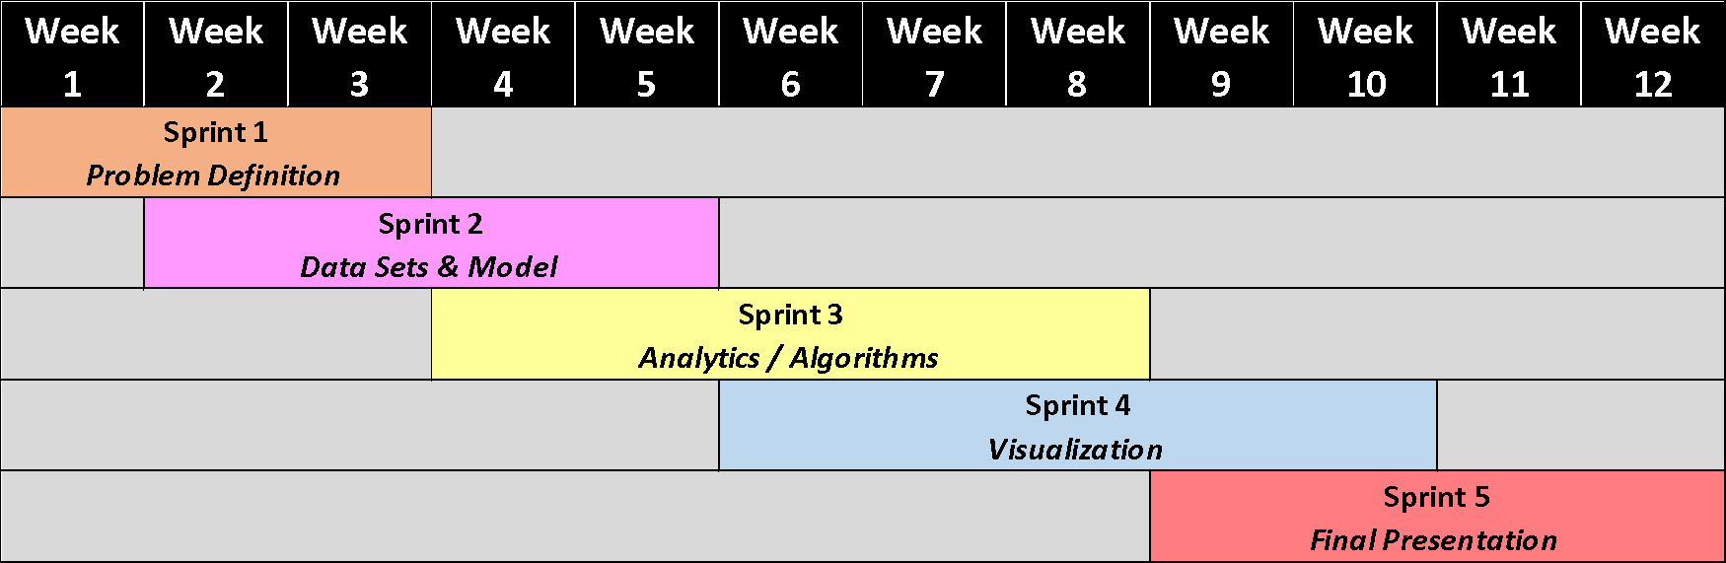
Agile Parallel Sprint Plan

Slide 60
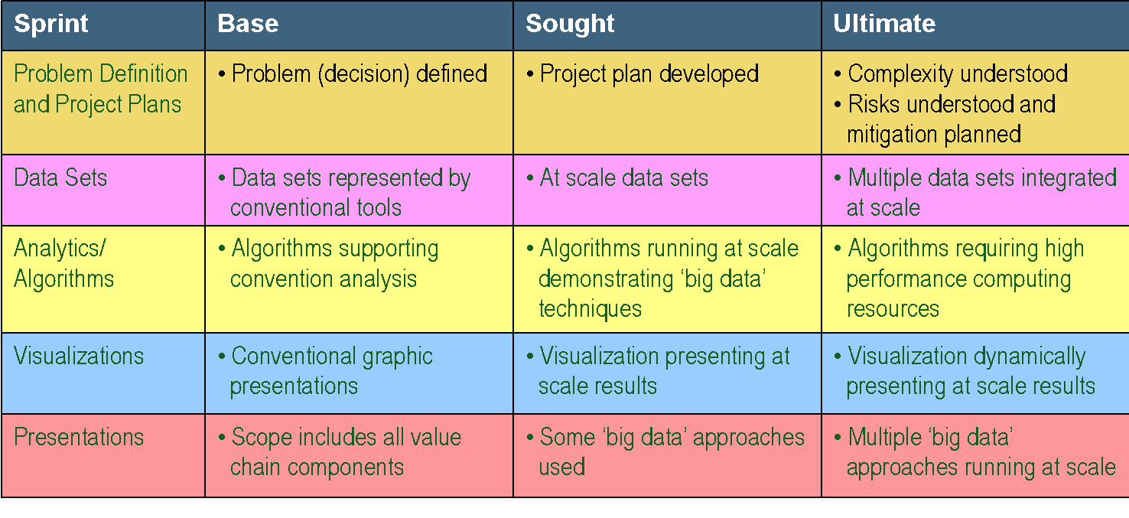
Complexity

Slide 61
Risks and Planned Mitigations
Analytic methods fail to yield useful findings
Probability: medium
Impact: high
Mitigations:
Apply broad array of data science techniques
Failure to integrate meaningful data
Probability: low
Impact: medium
Mitigations: pursue other data sources, engineer features
State/County-level socioeconomic data – ongoing
Failure to meet deadlines with all deliverables
Probability: medium
Impact: medium
Mitigation: parallel Sprints (prototype early)
Failure to succinctly define veracity
Probability: medium
Impact: medium
Mitigation: understand the limitations of NIBRS as a data source
Data exceeds processing capabilities
Probability: low
Impact: low
Mitigation: take subset of data

Slide 62
Assumptions
Data
NIBRS is a reliable source of crime data
The incomplete participation in NIBRS will not overly influence findings
Missing data is not a problem
Modeling
Available data contains a sufficient number of characteristics to represent the crimes that took place
Methods exist to provide a useful level of model interpretation
Planning
Project can be adequately executed in a 12-week period

Slide 63

Data sources
National Incident-Based Reporting System (NIBRS)
Primary source of crime data
United States Bureau of Justice Statistics
Law enforcement agency information
United States Census Bureau and Data.gov
State/County-level socioeconomic data

Slide 64
NIBRS Project Data Set Construction
Five “Segment” files from each year (2013 – 2016)
Started with Victim file
Reduced to victims under the age of 18
Created 1 row for each victim-offense association
(Up to 10 offenses per victim )
Filter down to offenses of interest
Created 1 row for each victim-offense-offender association
(Up to 10 offenders per victim)
Execute a series of left join operations to the modified Victim data frame
Victim ← Offense ← Offender ← Batch Header ← Administrative
Repeat for files from each year
Bind rows and condition data
2016 Files Sizes

Slide 65
NIBRS Dataset Conditioning
Target variable labeling
Binary field for each offense category
Consolidated certain categorical variables
Created independent binary variables:
Identified and removed duplicates

Slide 66
Final Base Dataset for NIBRS
Total size: 372 MB
Number of variables: 82
Number of observations: 1,137,211

Slide 67
Data Assessment
Data Completeness
Percentage of missing and unknown did not overly influence the analysis
Data Uniqueness
Approximately 7,000 duplicates were found and removed
Data Accuracy
There was a small percentage of accuracy issues with the victim-offender relationship field
Conformity
After initial exploratory data analysis, there were no issues found with data conformity

Slide 68

Overall Quality
Very few concerns about the quality of the data; however, the dataset has the following limitations:
Does not provide a representative sample of the United States
Data only has information on reported incidents, some offenses are more reported than others
Difficult to capture the complexities of crimes in a database

Slide 69
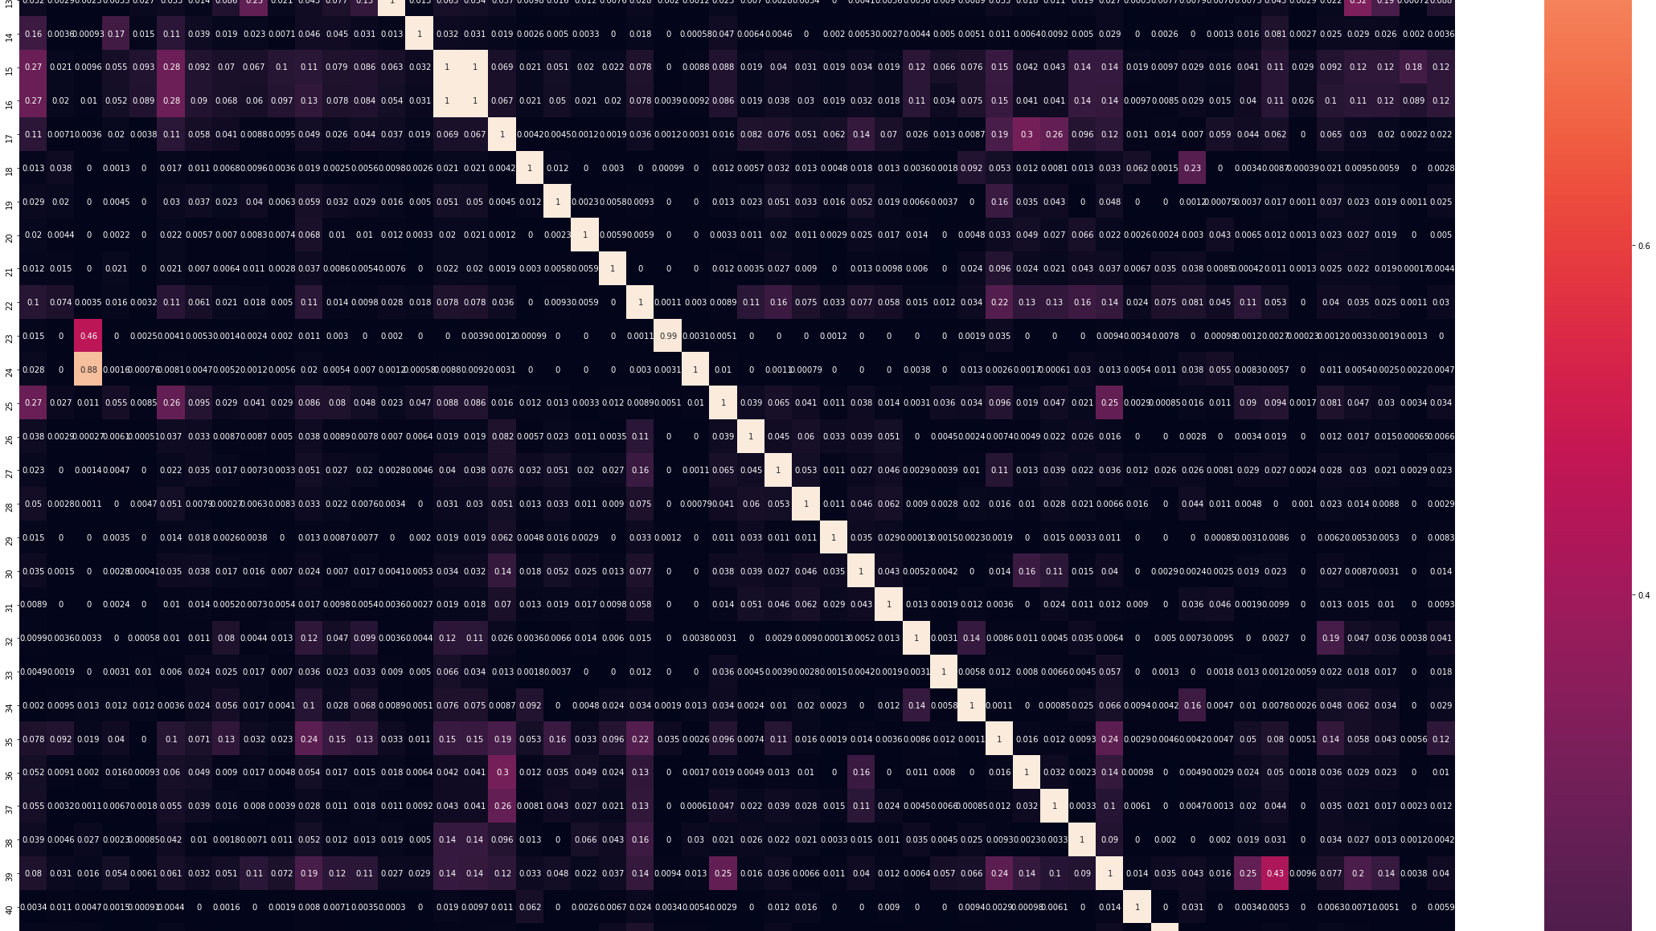
Correlation Chart – Categorical Variables

Slide 70
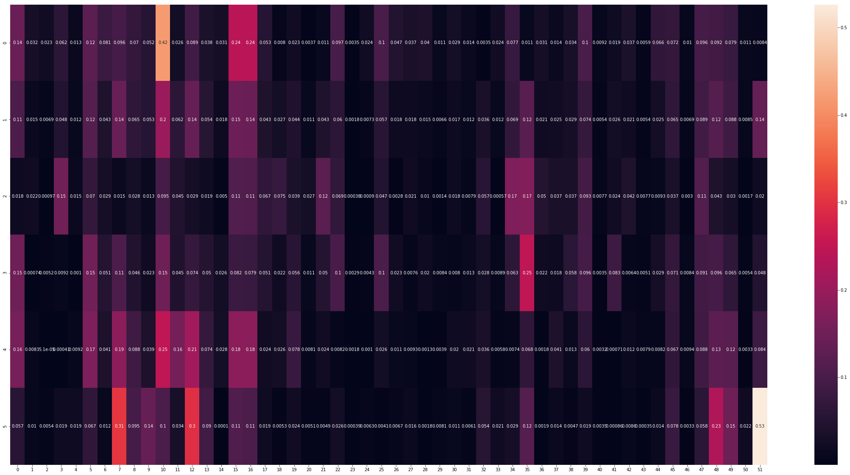
Continuous vs. Categorical Variable Correlations

Slide 71
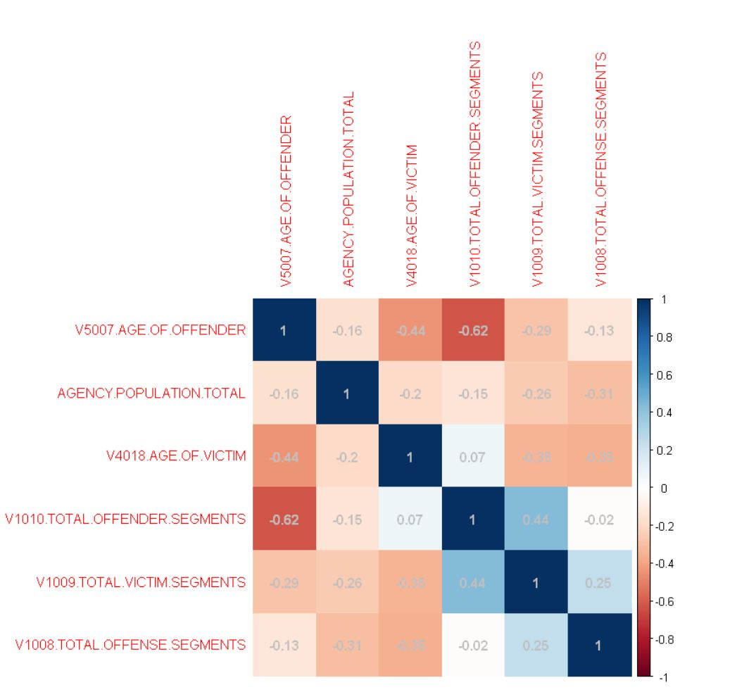
Correlation Chart – Continuous Variables

Slide 72
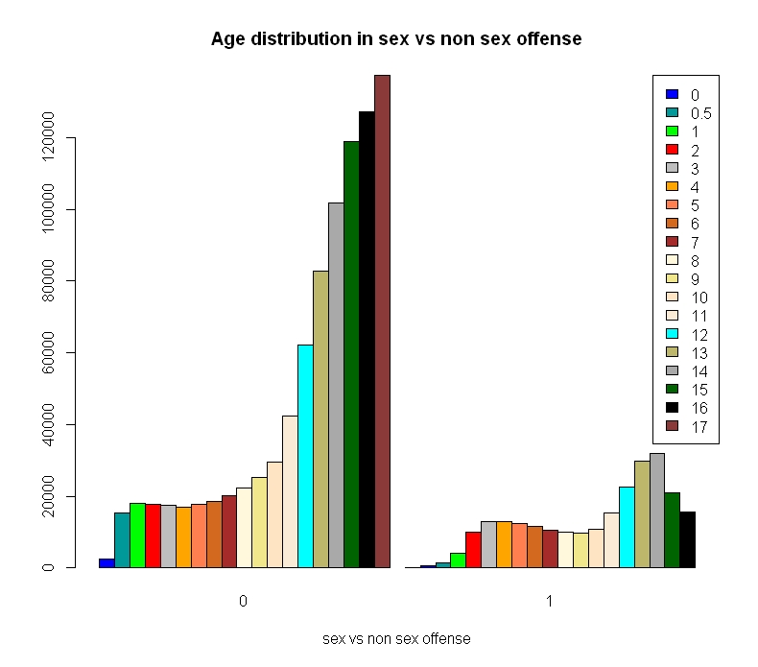
Victim’s Age Distribution

Slide 73
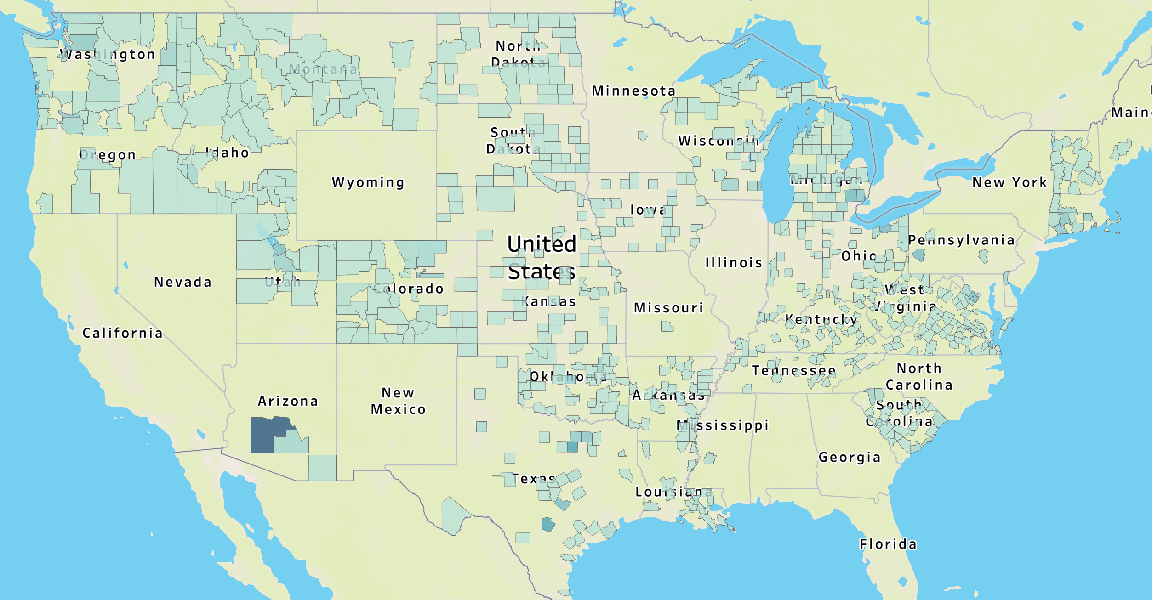
County Population
Color represents population in each county

Slide 74
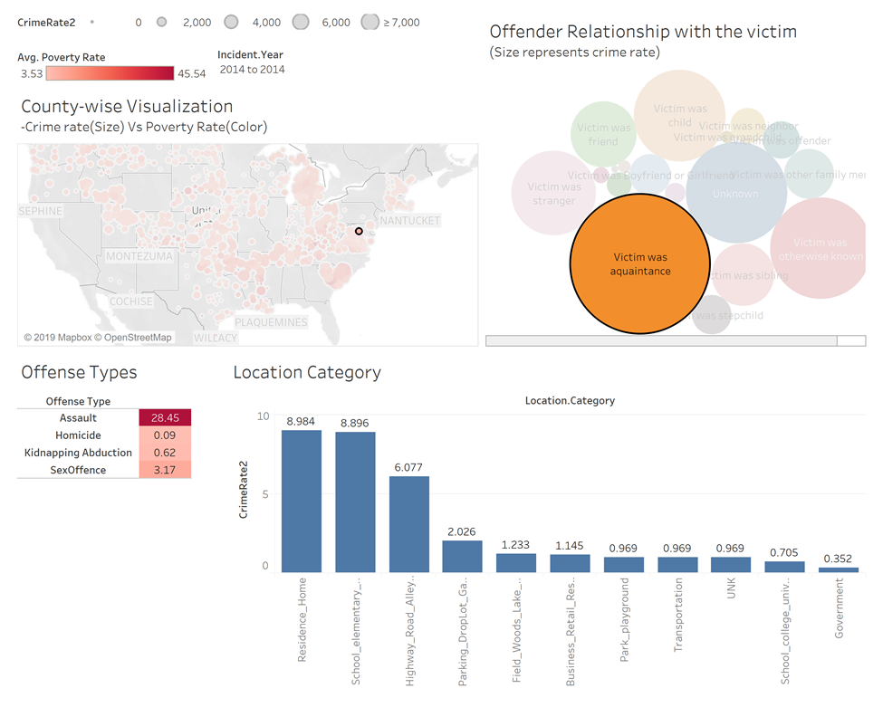

Slide 75
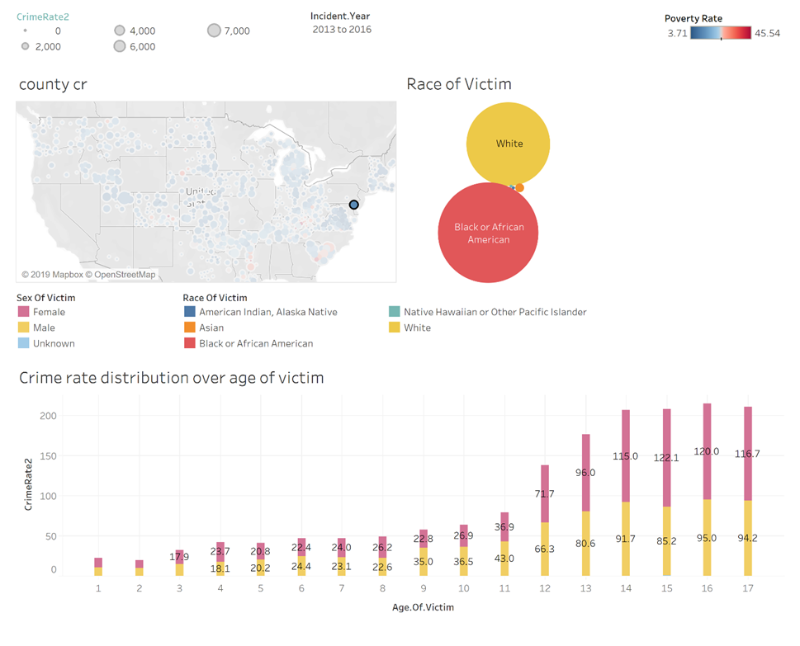

Slide 76
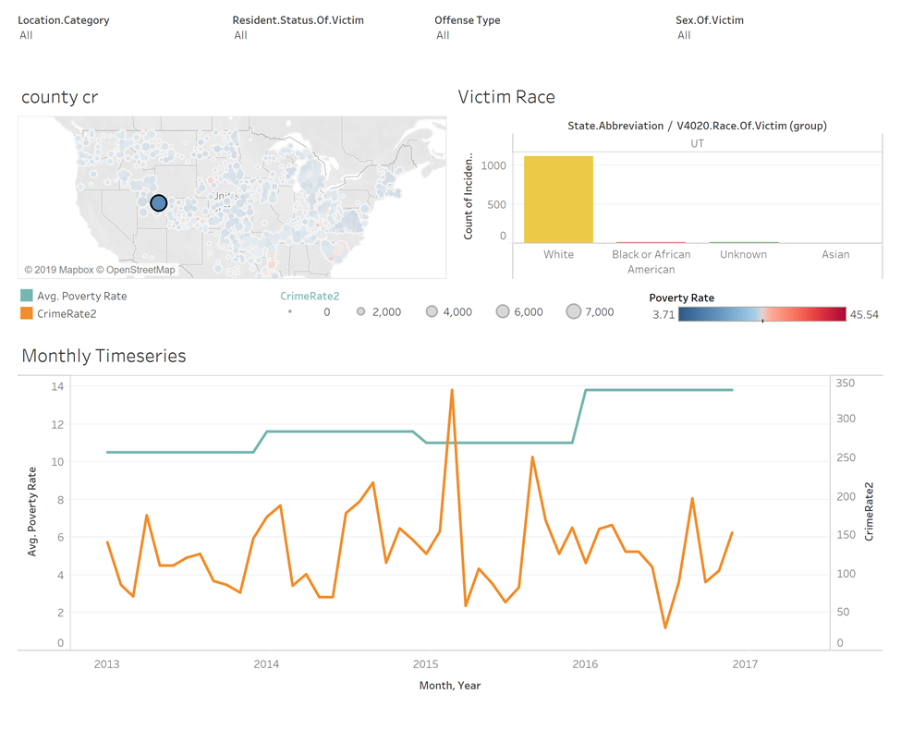

Slide 77
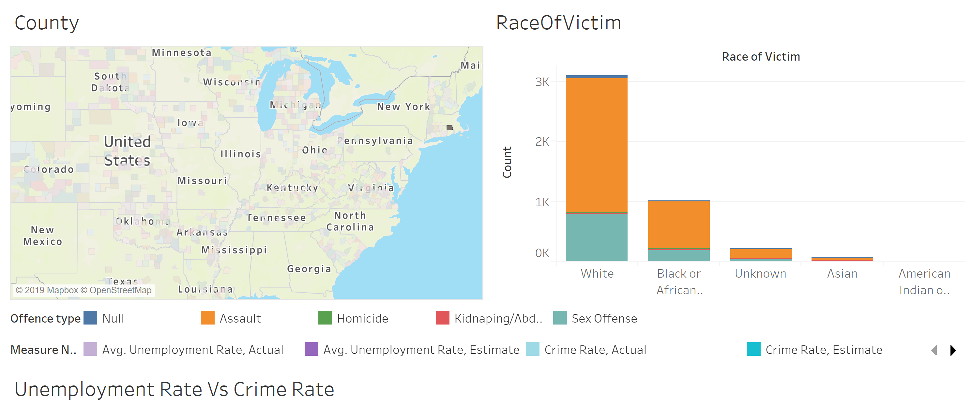
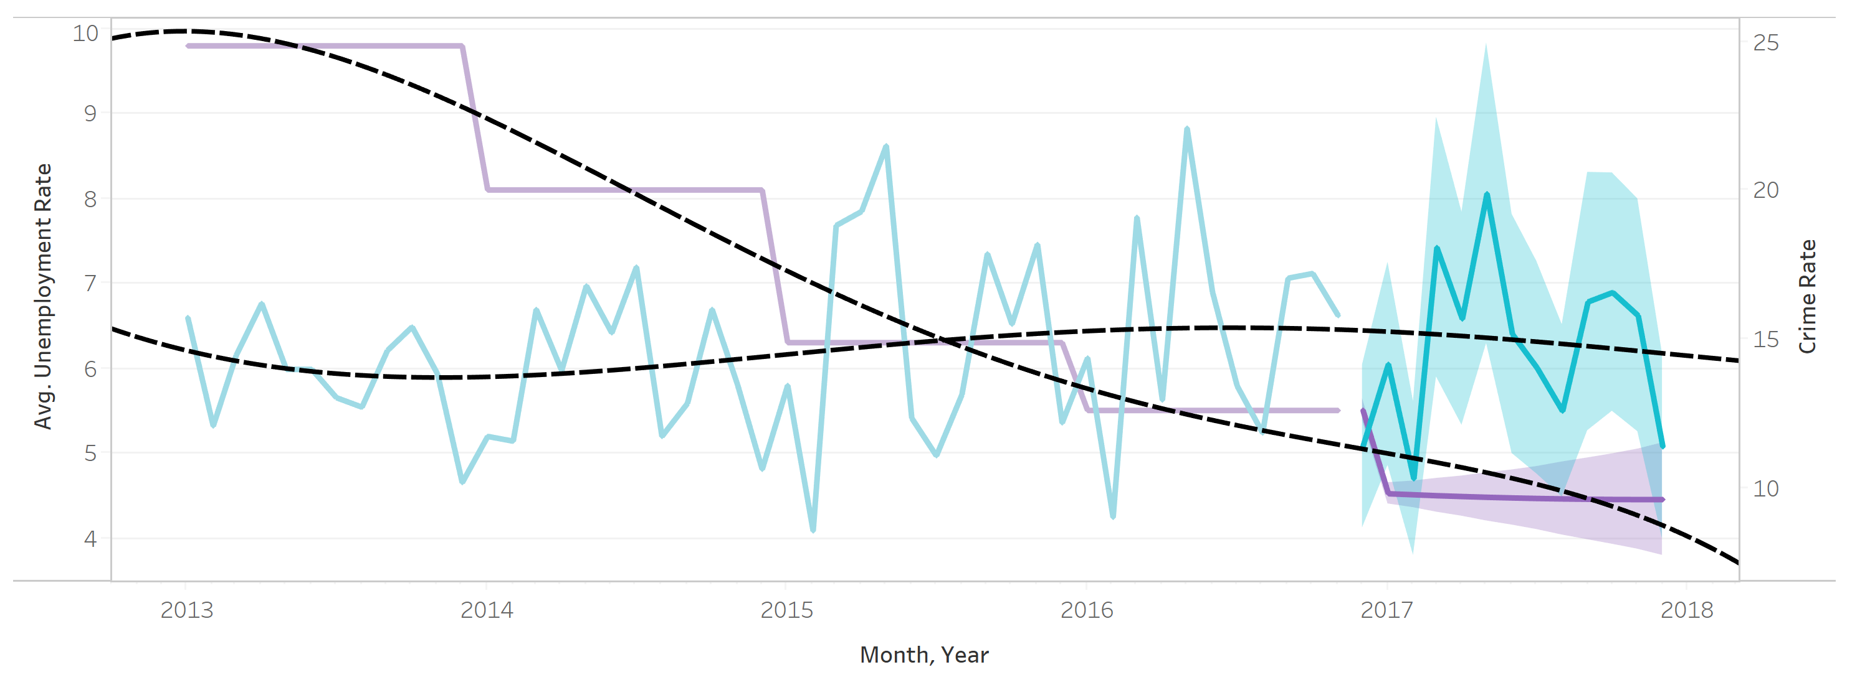

Slide 78

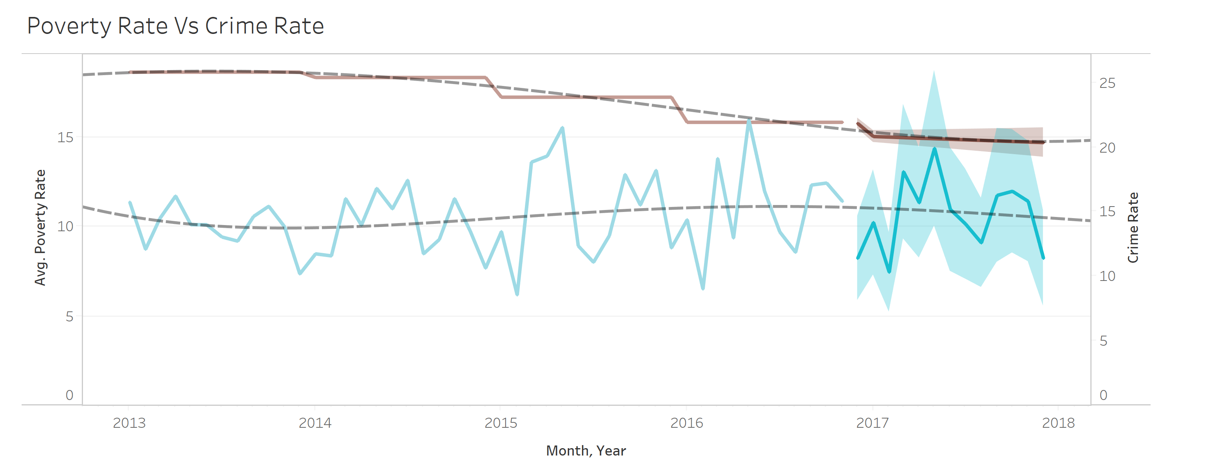

Slide 79
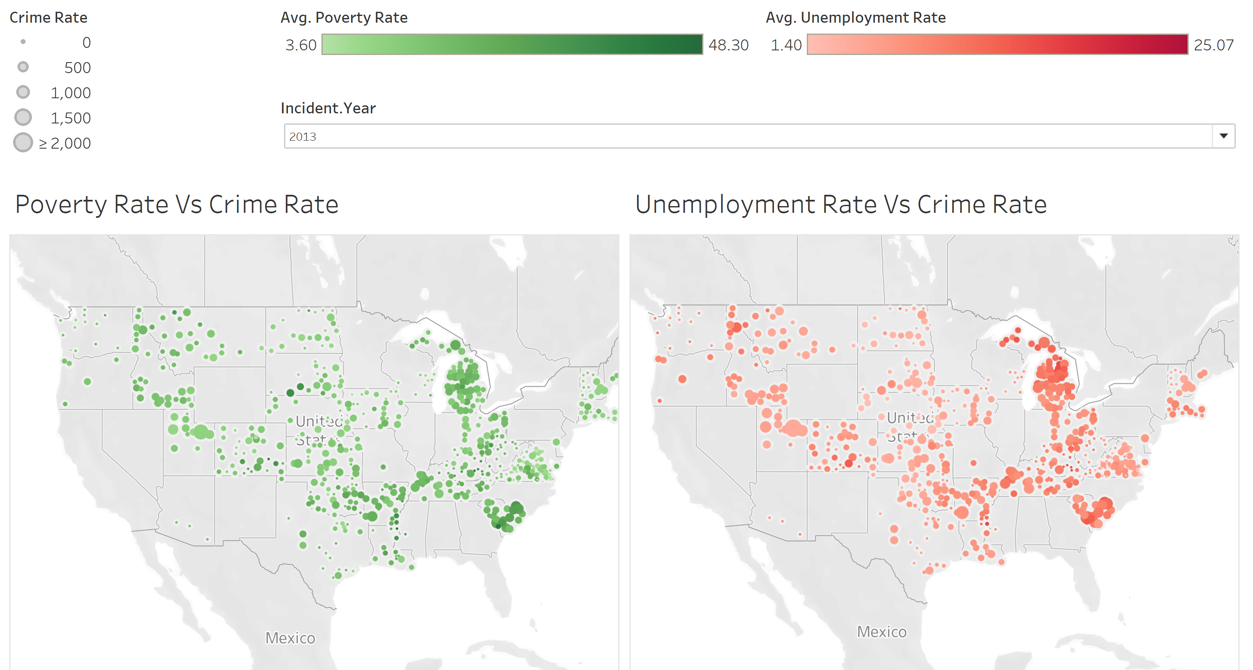

Slide 80
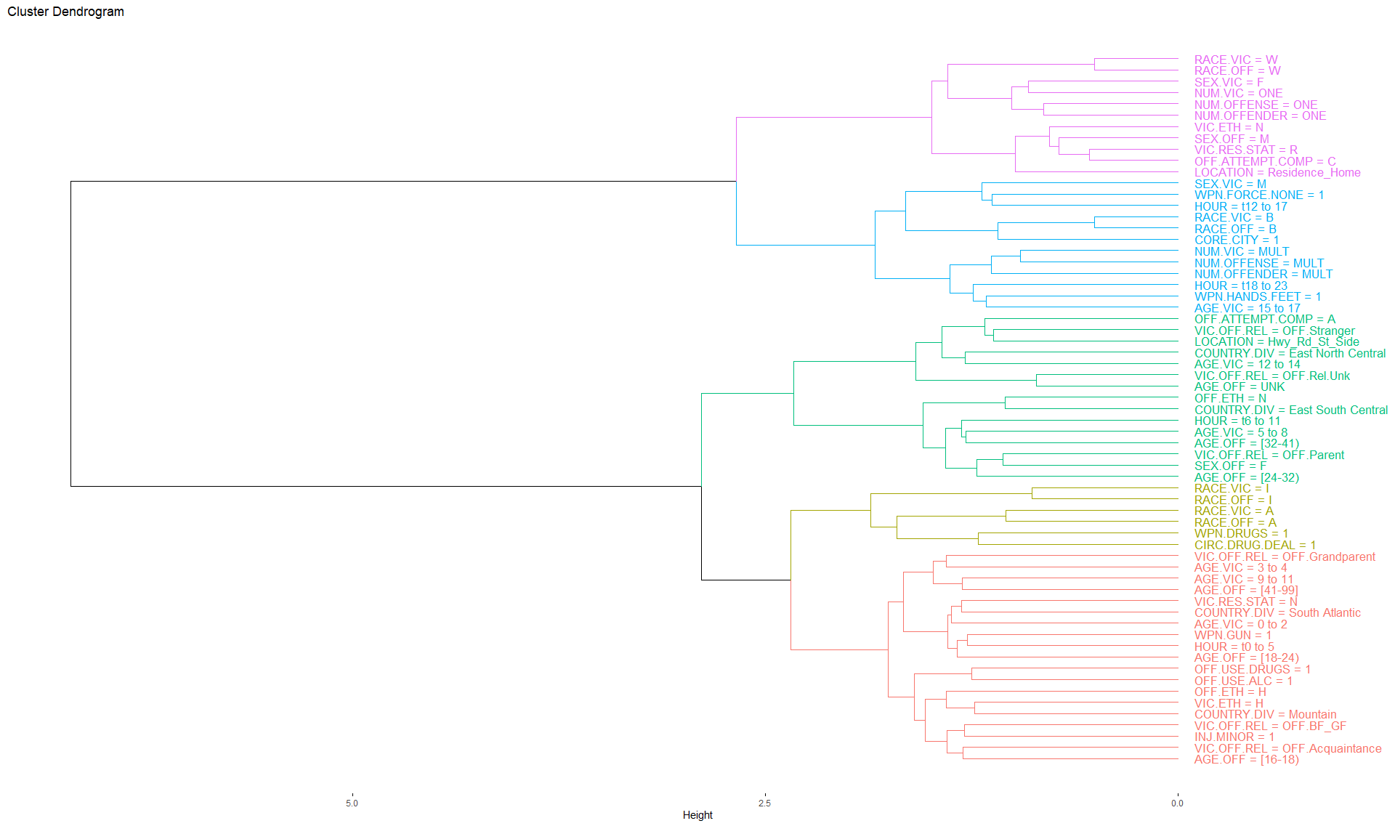
Kidnapping/Abduction
Notes:
Each leaf of the dendrogram represents a feature
As we move up the tree, leaves begin to fuse into branches
Correspond to features that are similar to each other
As we move higher up the tree, branches fuse with leaves or other branches
Low tree fusion indicates more similarity among features
Features that fuse toward the top of the tree are most different

Slide 81
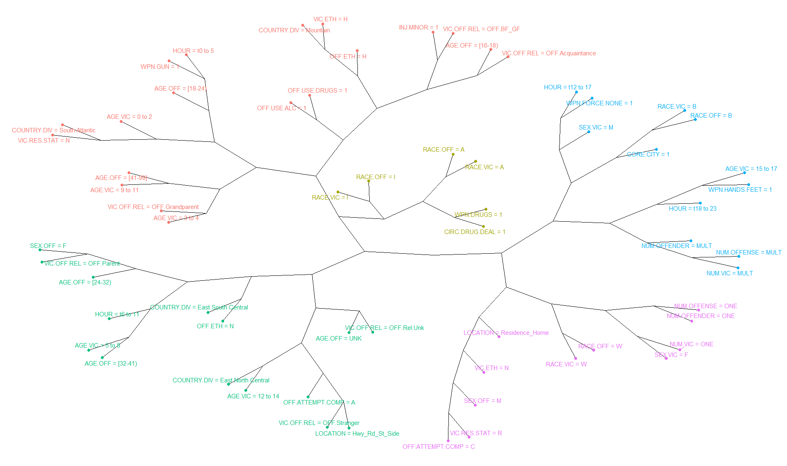
Kidnapping/Abduction
Offenders Aged 16 to 18
Victim and Offender are Boyfriend/Girlfriend
Offenders using drugs and/or alcohol
In the Mountain country division
Victims aged 0 to 2
Offenders aged 18 to 24
Time is midnight to 0500
Using gun as a weapon
In the South-Atlantic country division
Male victims
Time is 1200 to 2300
Using hands/feet as weapons
Multiple victims, offenders, and offenses
In a city environment
Victims aged 3 to 4 and 9 to 11
Offender is Grandparent
Victim aged 5 to 8
Offender is female parent aged 24 to 41
Time is 0600 to 1100
In the East-South-Central country division
Female victim
Male offender
Offense occurs in a residence/home
One victim, one offender, one offense
Victims aged 12 to 14
Attempted offenses along roads/highways
Offender a stranger or unknown
In the East-North-Central country division

Slide 82
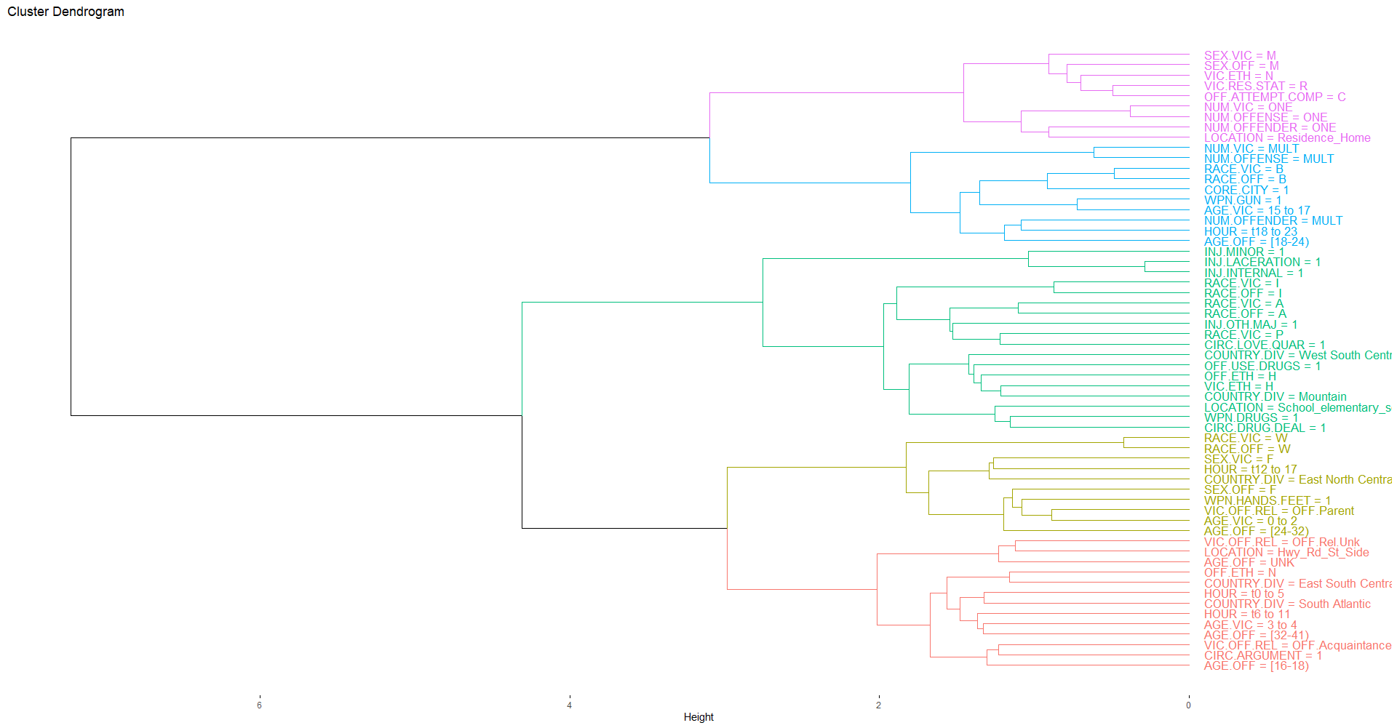
Homicide

Slide 83
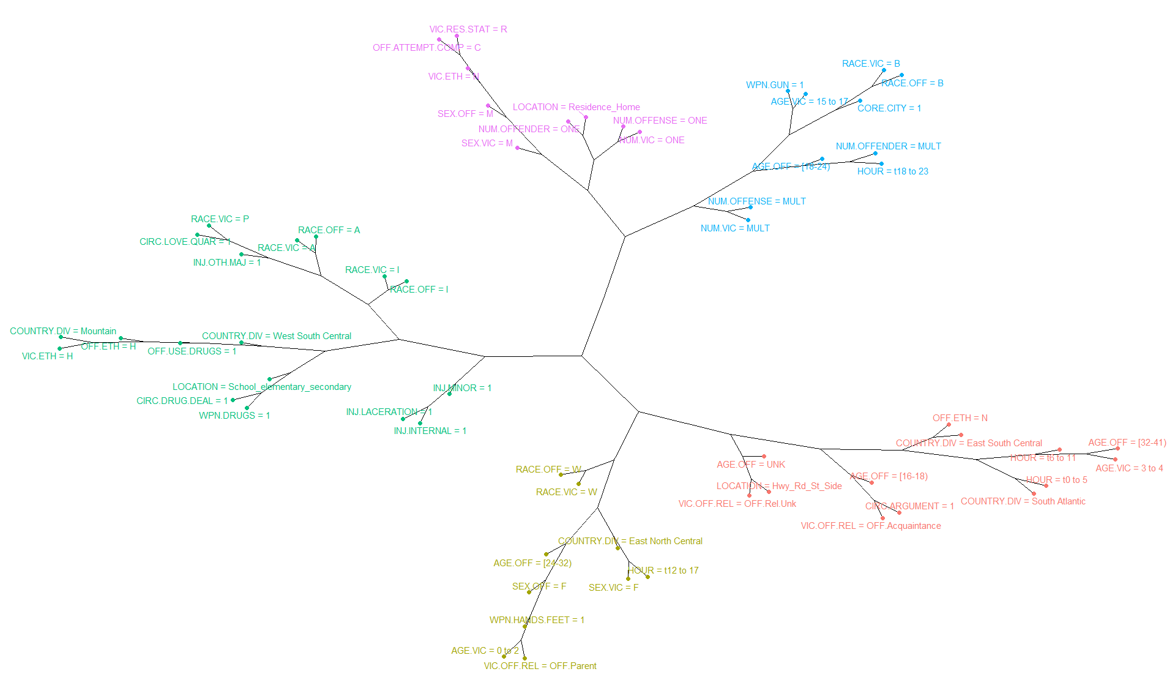
Homicide
Victim is male
Offender is male
Offense occurs in a residence/home
One victim, one offender, one offense
Victim is aged 15 to 17
Offender is aged 18 to 24
Time is 1800 to 2300
Gun used as a weapon
Multiple victims, offenders, and offenses
In a city environment
Drug dealing involved
Drugs as a weapon
Offender using drugs
Lacerations, internal, and other major injuries
In the Mountain and West-South-Central country divisions
Victims age is 3 to 4
Offender age is 16 to 18 or 32 to 41
Offender relationship is an acquaintance or unknown
Time is midnight to 1100 hours along roads/highways
Circumstances involve an argument
In the East-South-Central and South-Atlantic country division
Female victim aged 0 to 2
Female offender aged 24 to 32
Time is 1200 to 1700
Hands/Feet as weapons
In the East-North-Central country division

Slide 84
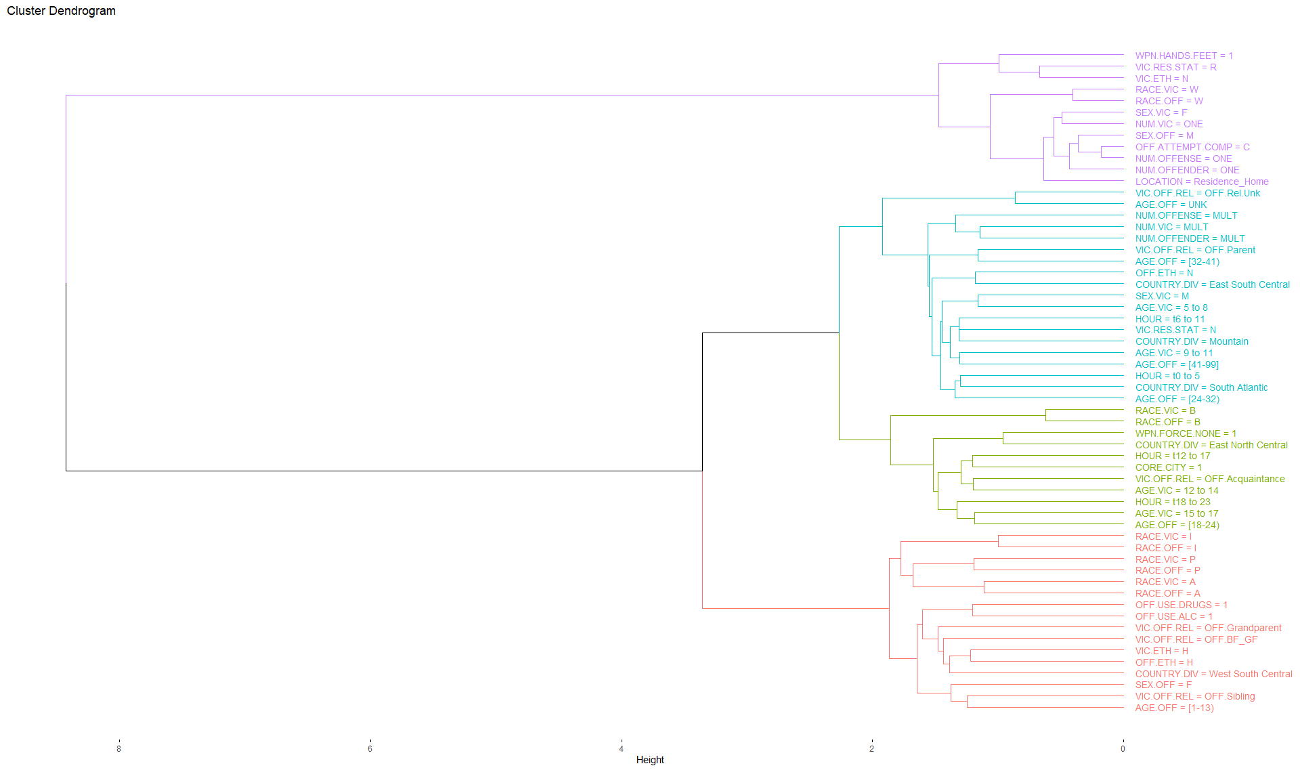
Sex Offense

Slide 85
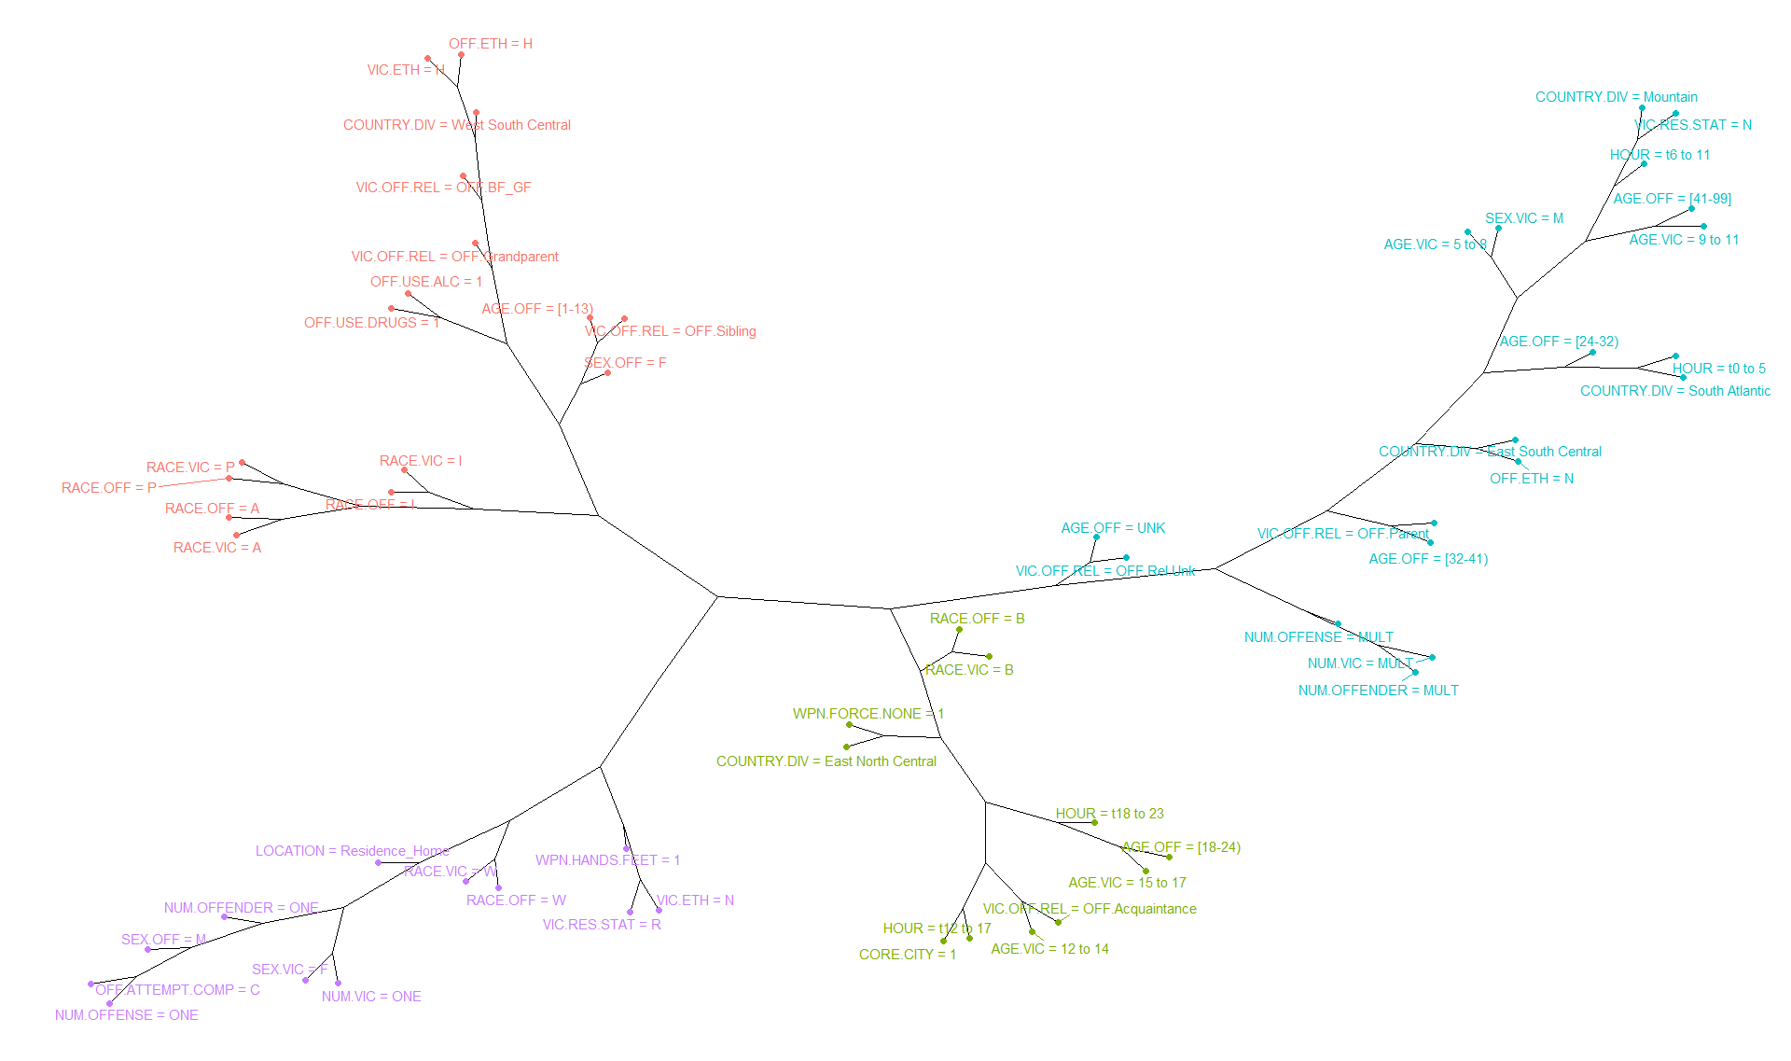
Sex Offense
Offender is sibling aged 1 to 13
Offender female grandparent
Offender is boyfriend/girlfriend
Alcohol and/or drugs involved
West-South-Central country division
Victim is male aged 5 to 11
Offender is parent or of unknown relationship aged 24 or older
Time is midnight to 1100
Multiple victims, offenders, and offenses
In the East-South-Central and South-Atlantic country division
Male offender
Female victim
Hands/feet as weapon
Offense in residence/home
Offense completed
Victim aged 12 to 17
Offender is an acquaintance aged 18 to 24
Time is 1200 to 2300
No weapon involved
In a city environment within the East-North-Central country division

Slide 86
Association Rule Learning
Useful for discovering interesting relationships hidden in large data sets
Association Rules
Expressions of the form X → Y, where X and Y are itemsets
Example: {Milk, Diaper} → {Beer}
Rule Evaluation Metrics (Strength of Association)
Support (s)
Fraction of transactions that contain both X and Y
i.e., how often a rule is applicable to a data set
Confidence (c)
Measures how often items in Y appear in transactions that contain X
Example:
$$s=\frac{count(\text{Milk},\text{Diaper}\text{, }\text{Beer})}{N}=\frac{2}{5}=0.4$$
$$c=\frac{count(\text{Milk}\text{, }\text{Diaper}\text{, }\text{Beer})}{count(\text{Milk},\text{Diaper})}=\frac{2}{3}=0.67$$
Pang-Ning Tan, Michael Steinbach, and Vipin Kumar. 2005. Introduction to Data Mining, (First Edition). Addison-Wesley Longman Publishing Co., Inc., Boston, MA, USA.
67% of the customers who bought milk and diapers also bought beer

Slide 87
Association Rule Learning
Reducing list down to “meaningful” rules:
is.significant
Find rules where the LHS and the RHS depend on each other using Fisher's exact test
is.redundant
Finding “interesting” rules, rather than just frequent:
Odds Ratio
Odds of finding LHS in transactions with RHS divided by the odds of finding LHS in transactions without RHS

Slide 88
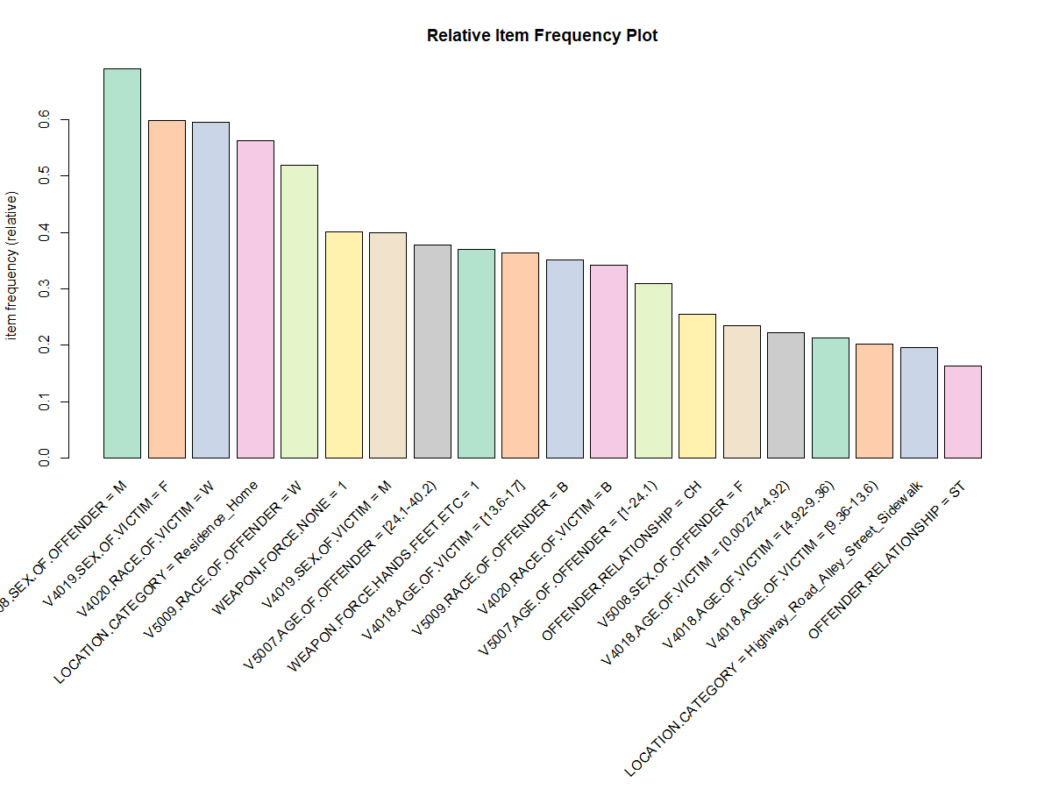
Association Rule Learning
Relative Frequencies of Kidnapping/Abduction
Indicators

Slide 89
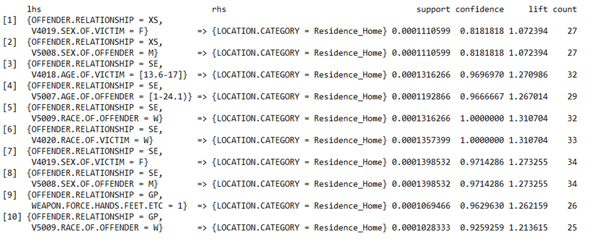
Association Rule Learning
Association rules for sex offenses that take place in a residence/home:

Slide 90
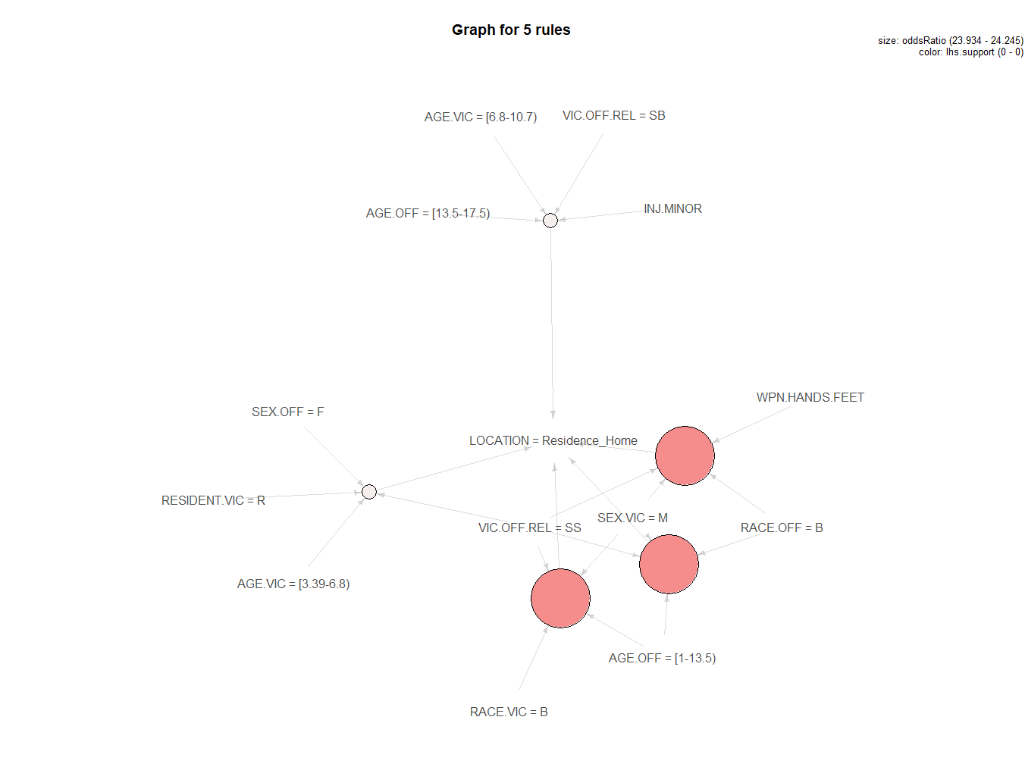
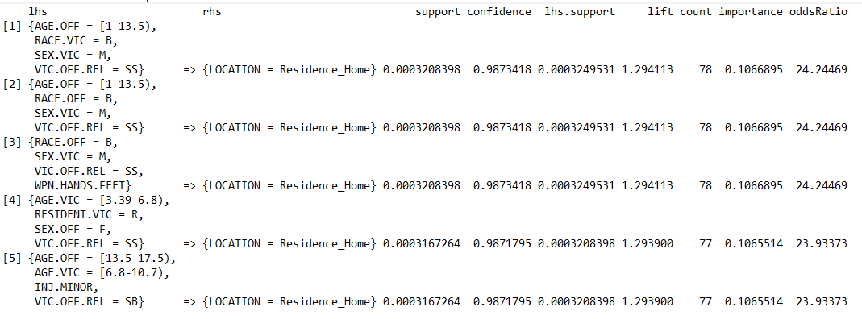
Association Rule Learning

Slide 91


Kidnapping/Abduction
Top 5 Rules for AGE.VIC = 15 to 17
Top 5 Rules for AGE.VIC = 12 to 14
Association Rules

Slide 92


Kidnapping/Abduction
Top 5 Rules for AGE.VIC = 9 to 11
Top 5 Rules for AGE.VIC = 5 to 8
Association Rules

Slide 93


Kidnapping/Abduction
Top 5 Rules for AGE.VIC = 3 to 4
Top 5 Rules for AGE.VIC = 0 to 2
Association Rules

Slide 94

94

Slide 95

95

Slide 96

K-Modes Cluster Analysis

Slide 97

Data Balancing with SMOTE
Several ways to balance the training set:
Oversample the minority class by replicating observations
Artificially lowers variance
Undersample the majority class
Information lost from throwing away data
Synthesize new minority classes by interpolating between existing ones
Synthetic Minority Oversampling Technique (SMOTE): Creates artificial data based on feature space based on similarities from minority samples
SMOTE Parameter Setting:
perc.over: Determines how many extra cases from the minority class are generated.
perc.under: Determines how many extra cases from the majority classes are selected for each case generated from the minority class
k: A number indicating the number of nearest neighbors that are used to generate the new examples of the minority class
$$xx = perc.over$$
$$yy = perc.under$$
$$n=original number in the minority class$$
Class | New Observation Count
Minority | （1+xx/100)*n
Majority | yy/100 *(xx/100)*n
svds.com/learning-imbalanced-classes

Slide 98
Logistic Regression with Elastic Net
Variable Importance Across Models

Slide 99


XGBoost Model
Build successive trees that learn from the previous one
Missing data interpreted as containing information, rather than missing at random
Trains on residuals from previous iteration, rather than dependent variables
Learns from incorrectly classified data
Shallow trees prevent overfitting
Many tuning parameters

Slide 100


Homicide vs Kidnapping

Slide 101

Network Graph for Target Assault

Slide 103

Random Forest Model
Grows many classification trees
Each tree gives a classification and acts as a “vote” for the class
Forest chooses the classification having the most votes
Challenging to work with:
Not as interpretable as linear methods
When model isn’t performing as well as expected, very hard to determine the cause
Long processing time

Slide 104


Random Forest
Find out the best mtry for random forest model, mtry=15
mtry: number of variables randomly sampled as candidates at each split

Slide 105

Random Forest Result
Accuracy rate 0.9415
Sensitivity 0.9365

Slide 106

Roc and AUC value
AUC value 0.986

Slide 107

Random Forest Variable Importance

Slide 108


ROC and Lift Chart

Slide 109


Partial Dependence Plot

Slide 110

Random Forest Rules

Slide 111


Neural Network
Set parameter
Two neurons which are the output node
The input node on the left side
Weight represent relative importance of the predictor
for example, the most important predictor in the neural network is location category followed by the type of weapon used, others include age of victim, circumstances, and sex of victim.
The output is computed by multiplying the input by the weight and passing the result through an activation function SoftMax.

Slide 112


Slide 113

IBM SPSS Factor Analysis on Location Types

